Slide 1
Wm Ted Evans, PhD, PE
2021 American Society for Engineering Education
North Central Section Spring Conference
West Virginia University
March 25, 2023
New Labs for Control Courses using Vision Systems – Cognex

Slide 2
Abstract
An exciting series of labs have been discovered that greatly enhance a course in automation controls for Engineering Technology students as well as for Electrical Engineering students. The Cognex company furnishes these labs with accompanying text and lab material that introduce the student to the concepts of vision part inspection using simple programming techniques. They include videos as well for a very complete course in this subject.

Slide 3
Introduction
A History:
The Purchase
The Set
The First Implementation
The Second Implementation
Going for it

Slide 4
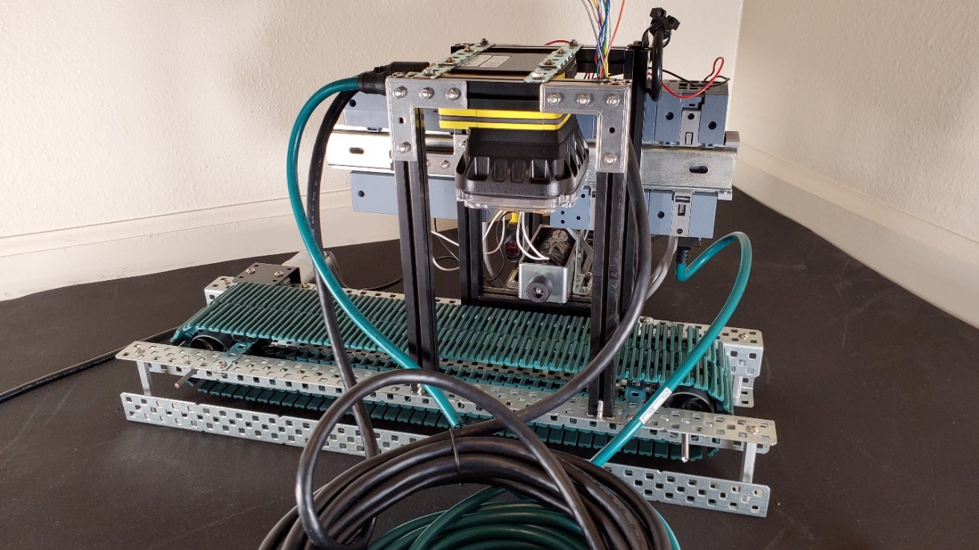
Introduction

Slide 5
This led the instructor to explore the Cognex system more thoroughly to see if the equipment could be used on a more general basis, not just in special projects.
What was found was a great number of helpful videos and labs for two different programming platforms. EZB (Easy Builder) and SS (Spreadsheet) were the two platforms. After examining the first videos, it was determined that all effort should concentrate on SS instead of EZB.

Slide 6
“In-Sight Spreadsheets Standard (TRN-IS-CGNX-STD) gives new or potential In-Sight users a 2 day overview of the hardware and software used by In-Sight vision systems. With the focus on getting the most from the In-Sight Explorer Spreadsheets interface, users learn how to walk through the process of setting up a vision application using spreadsheet programming best practices.

Slide 7
Expected Outcomes: At the end of this course, participants will be able to: –Identify In-Sight hardware and software interface components –Demonstrate skillful use of the: •Spreadsheet interface •Tools to solve vision inspections •Communication options of the system –Build starter operator interfaces –Explain the fundamentals of Lighting and Optics”

Slide 8
Videos accompanied the chapters were able to give a good understanding of the software and hardware. The software can be run in the emulate mode but with a student body mostly of hands-on students, the actual cameras furnished the incentive to use the actual versus simulated system software. There was no substitution for actually finding the part under the camera and honing in on the view being sought. The Cognex system relies on actual parts or pictures of parts.

Slide 9
Additions by Instructor
Mounting
Inspection Parts
Ethernet Connection
Power Supply
Shorter cables

Slide 10
Gains in First Try: Two courses: EET 4450 and EECS 4220 30/31 ET Students Successful 41/48 EECS Students (voluntary) Enthusiasm was palpable

Slide 11
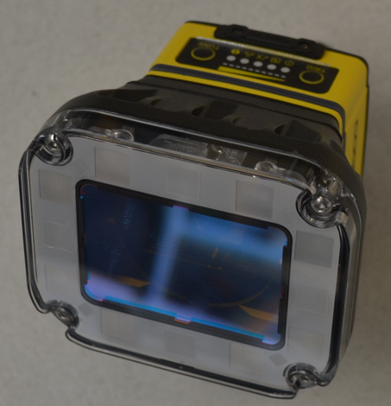
The Basic Camera - 7802

Slide 12
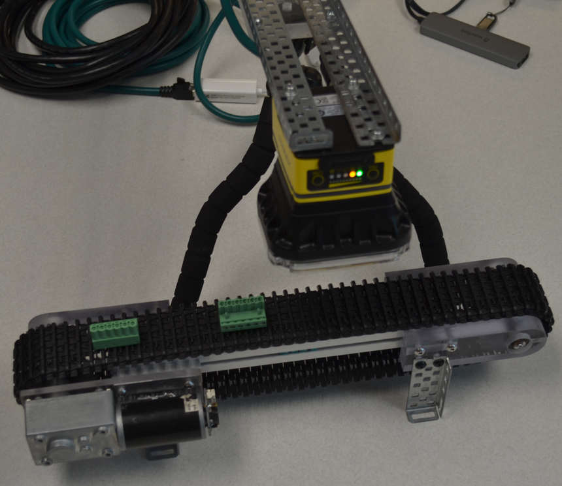
The Mount

Slide 13
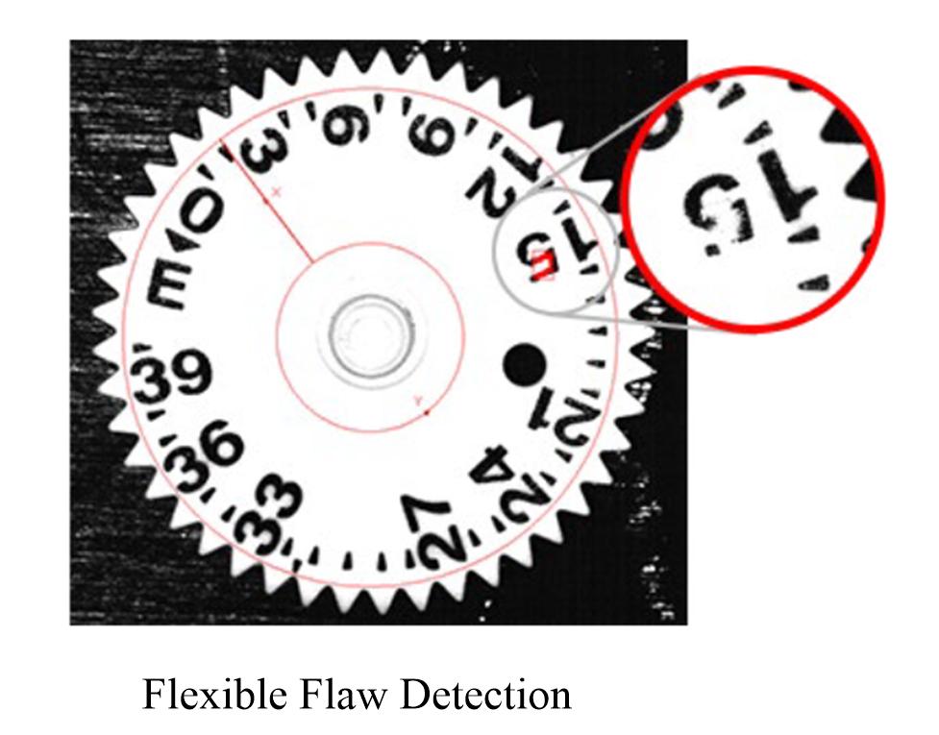
What It Can Do

Slide 14
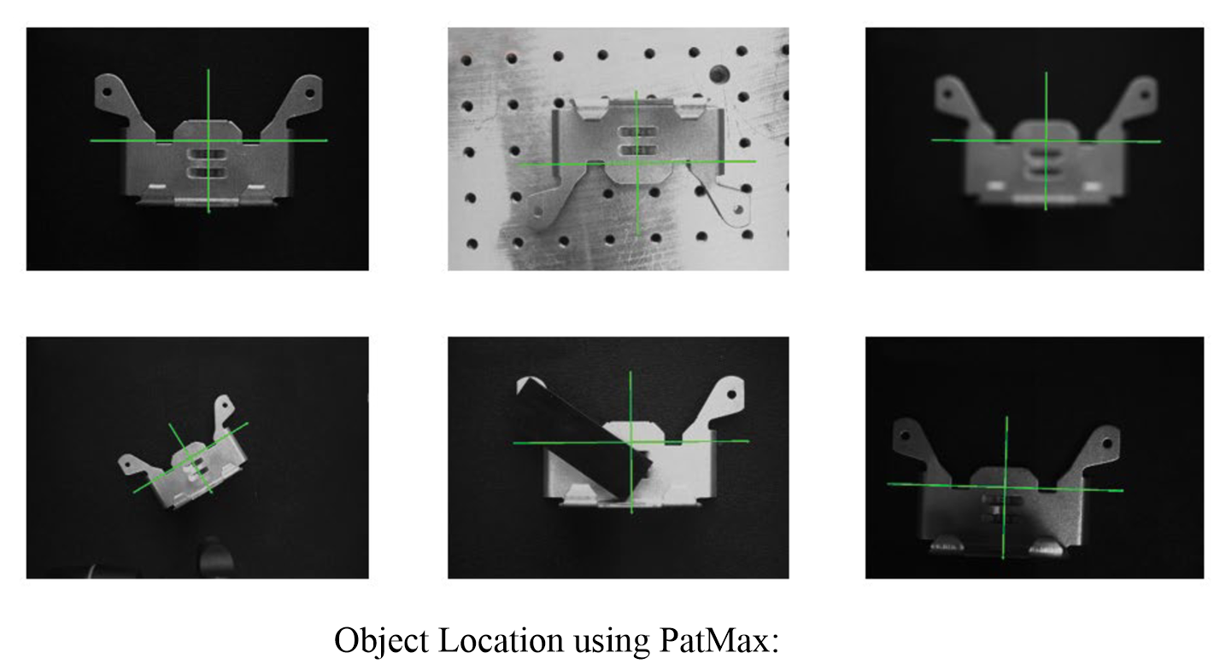

Slide 15
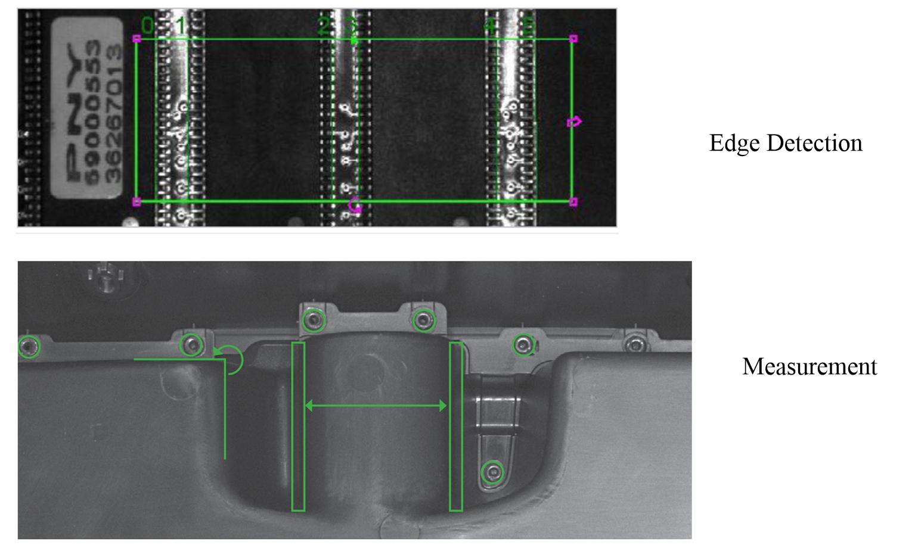

Slide 16
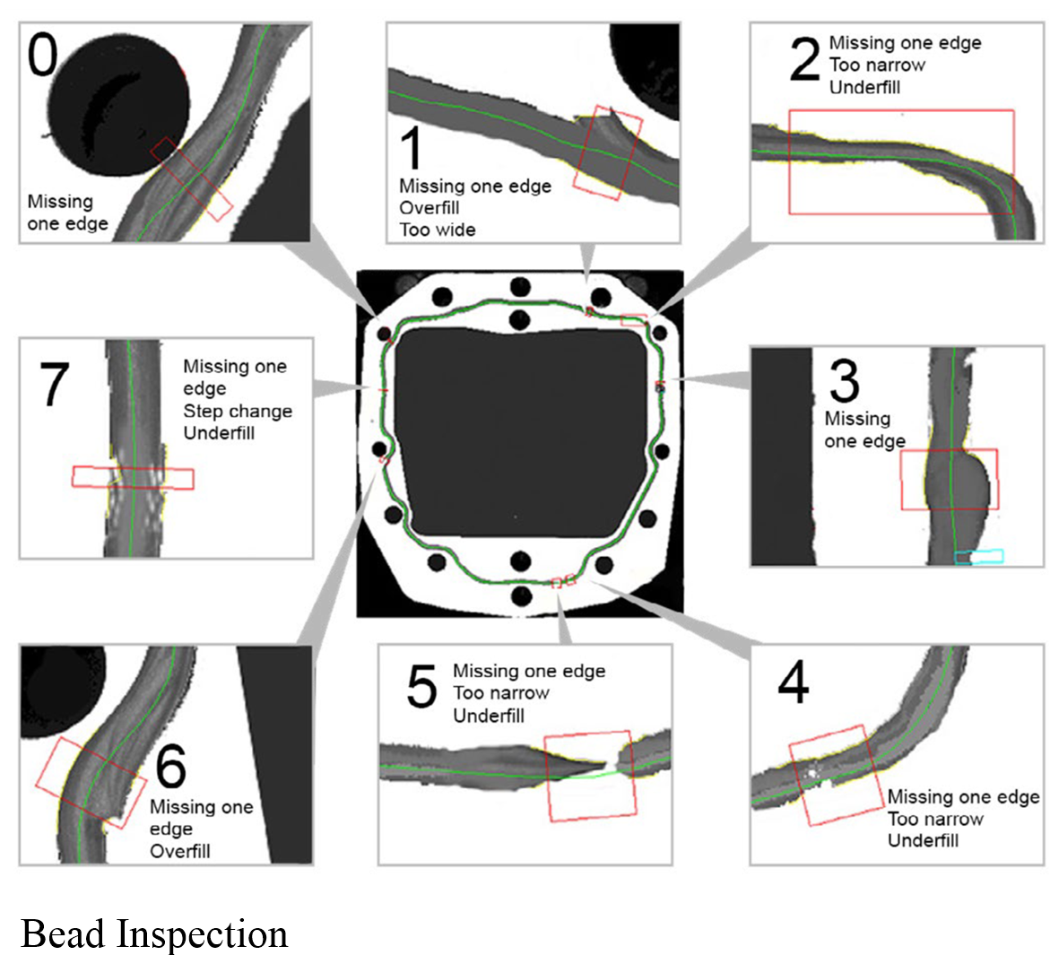

Slide 17
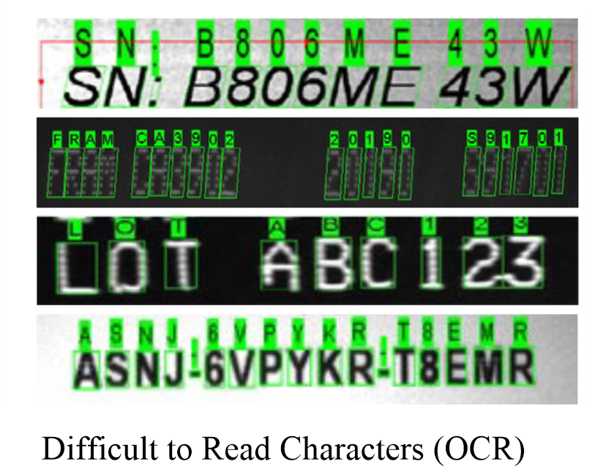

Slide 21
Summary
The Cognex equipment is state-of-the-art. It includes all that one needs to successfully implement a complete vision inspection station. The experience on these small units give a very good experience in how to set up and program more sophisticated industrial systems. Cognex is the leader in vision systems world-wide and knowledge of set-up of their systems is highly desired. Their labs are encouraged for anyone entering the automation field.

Slide 22
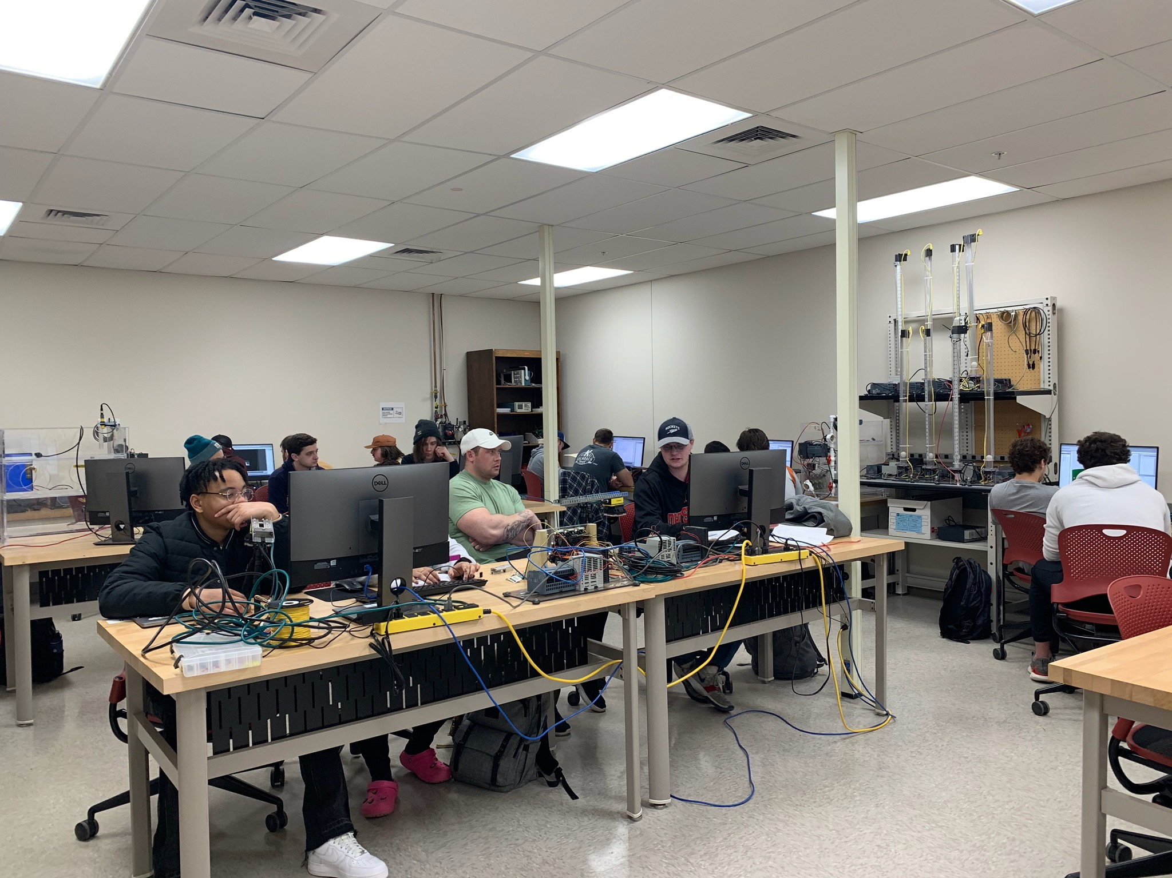

Slide 23
Questions????????
Website:
hybridplc.org
Youtube channel can be accessed via ‘videos’ at top of website page
Two texts at website (free):
Hybrid Text
Hybrid Lab Text

