Slide 1
Wm Ted Evans, PhD, PE
2021 American Society for Engineering Education
North Central Section Spring Conference
West Virginia University
March 25, 2023
New Labs for Control Courses DC Motor Control

Slide 2
Abstract
A number of labs have been developed using small scale dc motors that demonstrate the PID algorithm for speed and position control. These labs are very inexpensive and complement the PLC equipment presently in most automation labs. The labs will demonstrate the basic concepts of PID and the concept of loop-in-loop control.

Slide 3
Introduction
This lab has a history from a number of previous developers. One was the original lab for the Auto Controls course manufactured by a former instructor in EET, John Rich. Its purpose was to control speed and then position using PID loops. The motor at right can be run both forward and reverse and to a position. The lab was the highlight of the AutoControl course by Mr. Rich during his tenure.

Slide 4
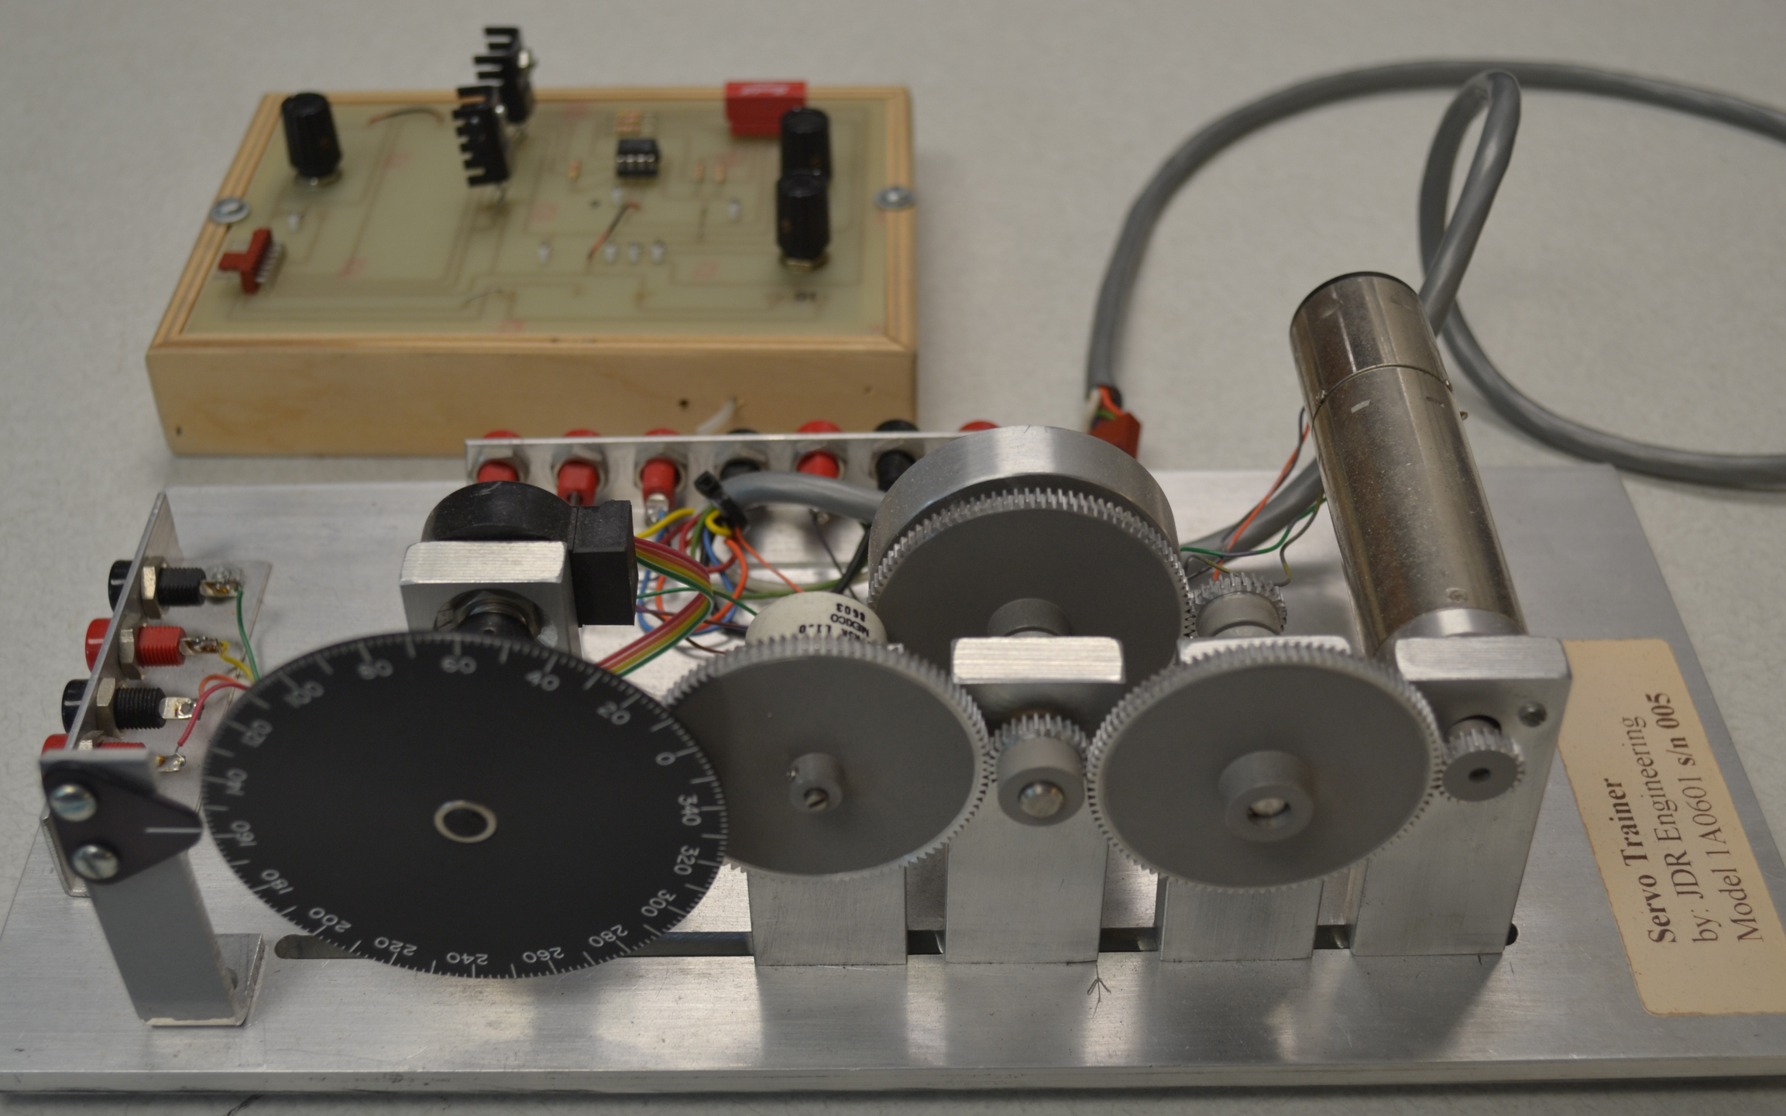
John Rich

Slide 5
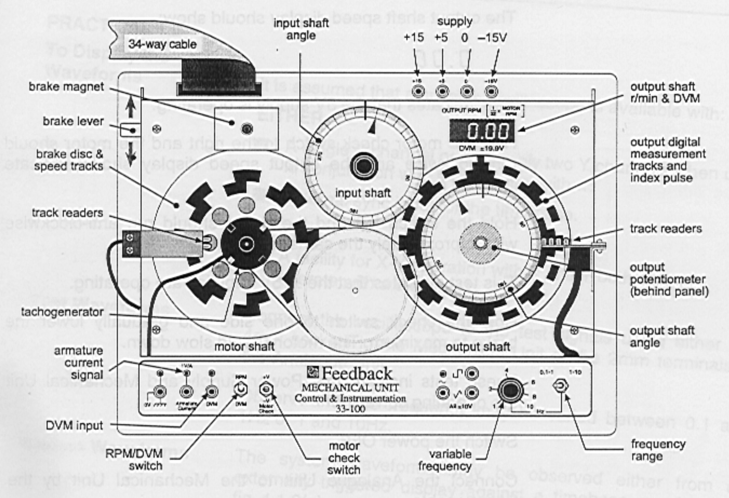
Feedback

Slide 6
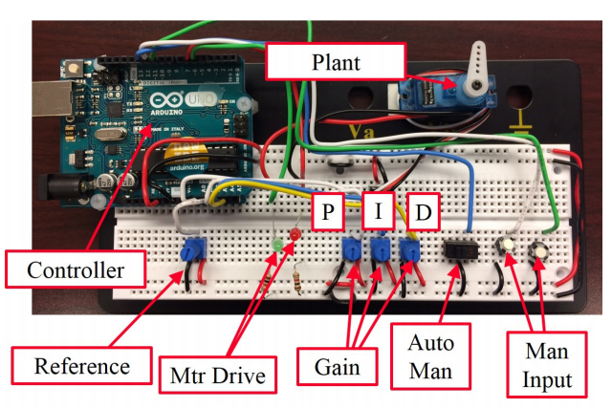
Cohenour

Slide 7
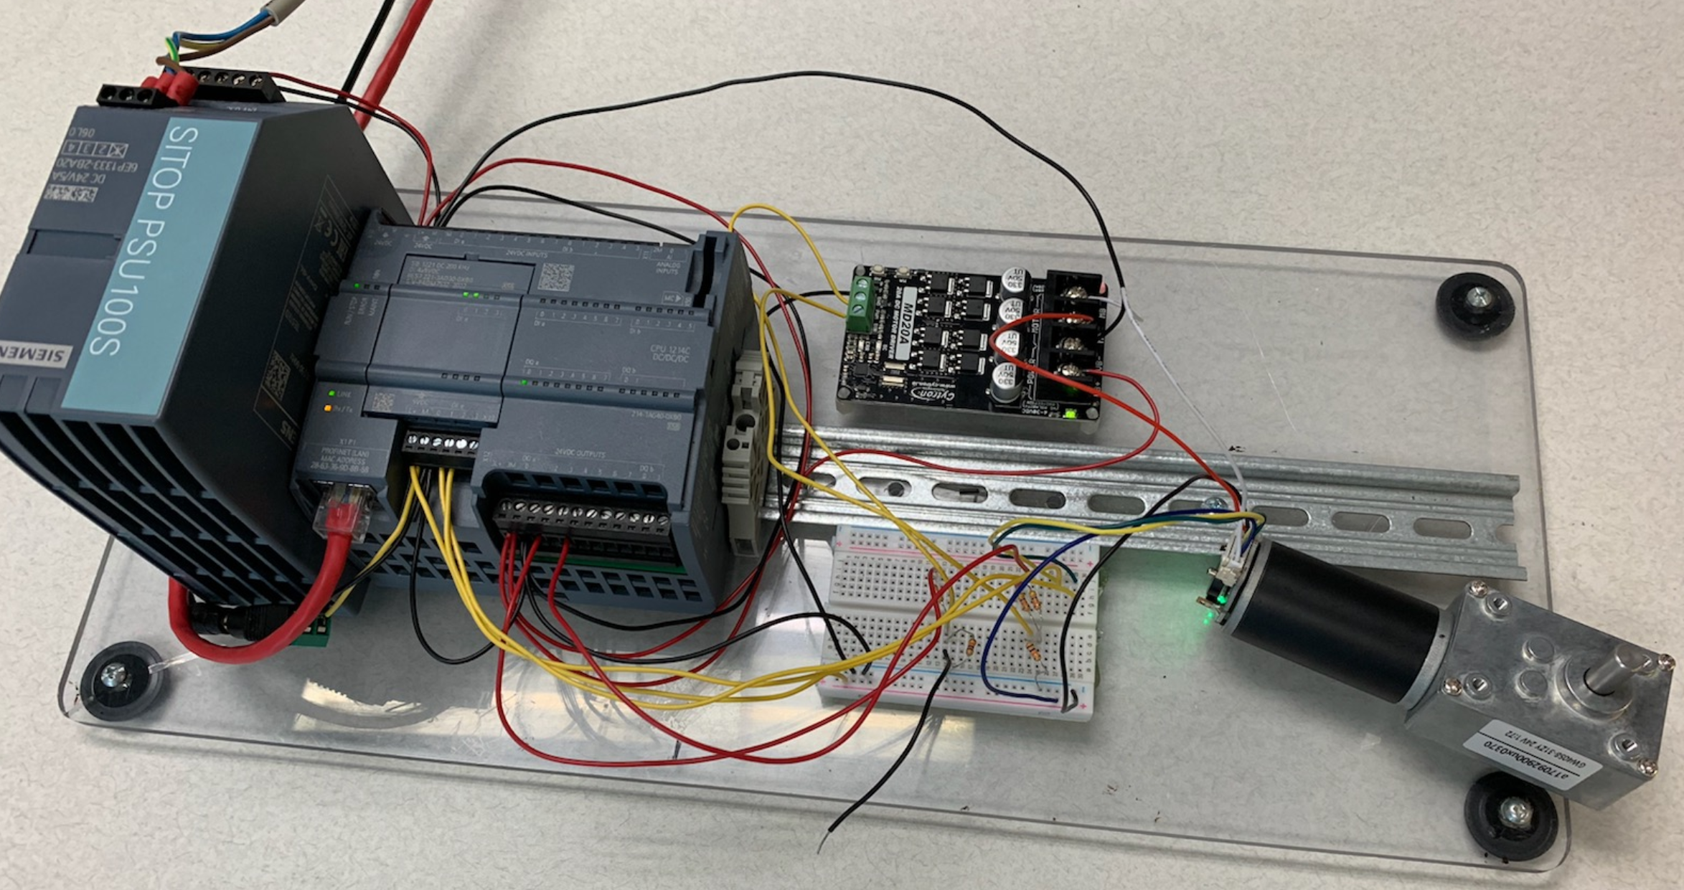
Siemens PLC Controller

Slide 8
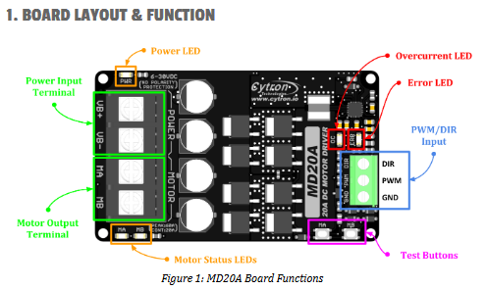
Control Board

Slide 9
Wiring

Slide 10
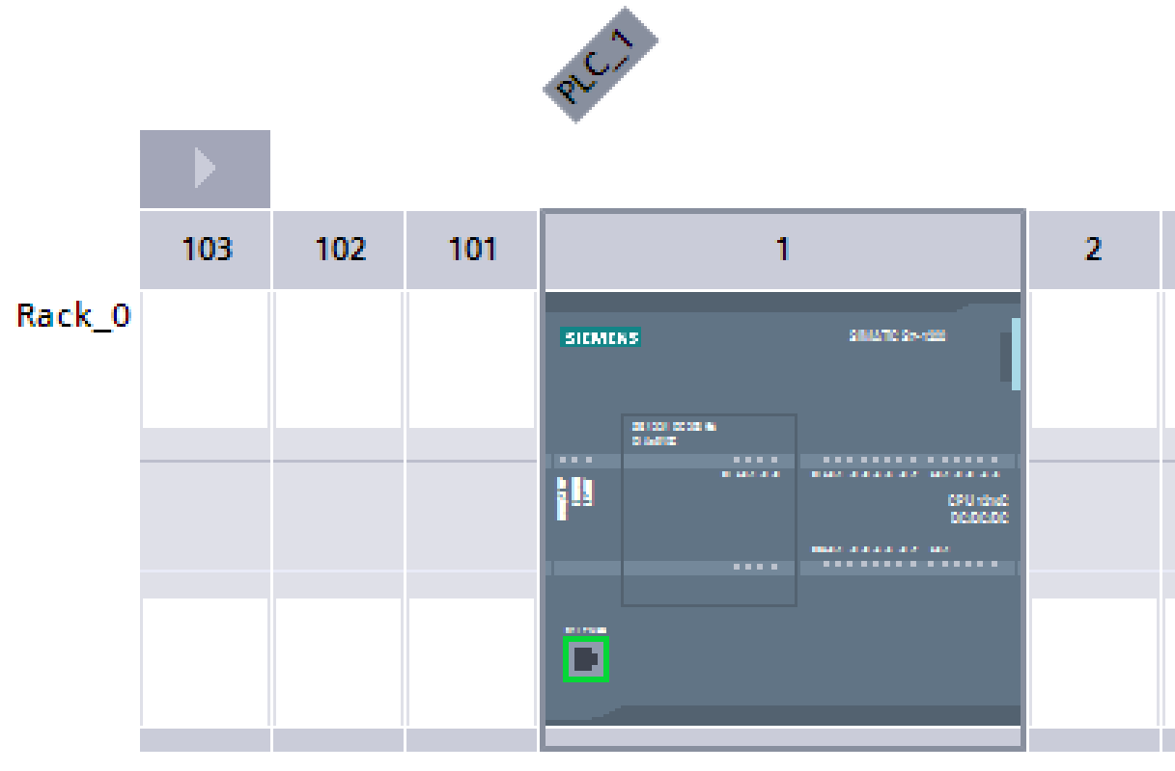
S7-1215 PLC

Slide 11
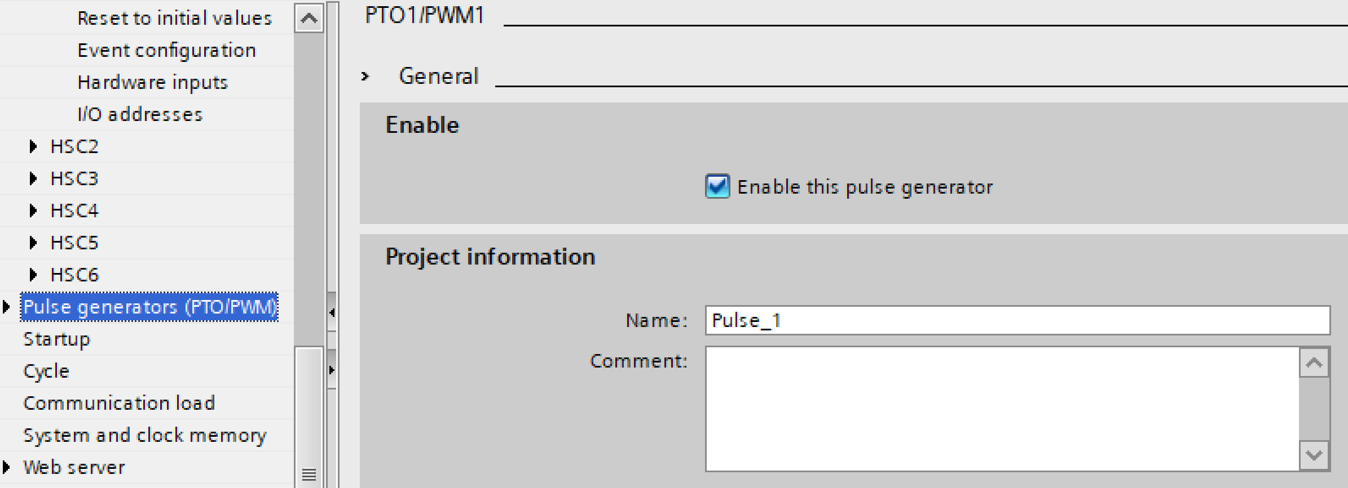
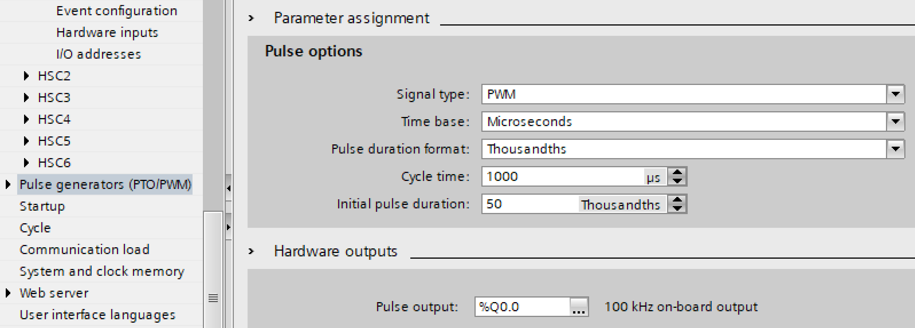
PWM Output

Slide 12
The program is in a cyclic interrupt program that is executed each 100 ms. It consists of a rung to get the input count for the last 100 msec followed by the PID block and finally the output to the PWM block. The choice of 100 ms is chosen due to the observation that with 11 pulses per revolution of the motor, we only receive about 125 pulses in 100 ms. If we were to choose 10 ms as our cycle time, we would only expect 12 pulses per scan at full speed. We need more accuracy than 1/12.

Slide 13
Capture of the Encoder Pulse

Slide 14
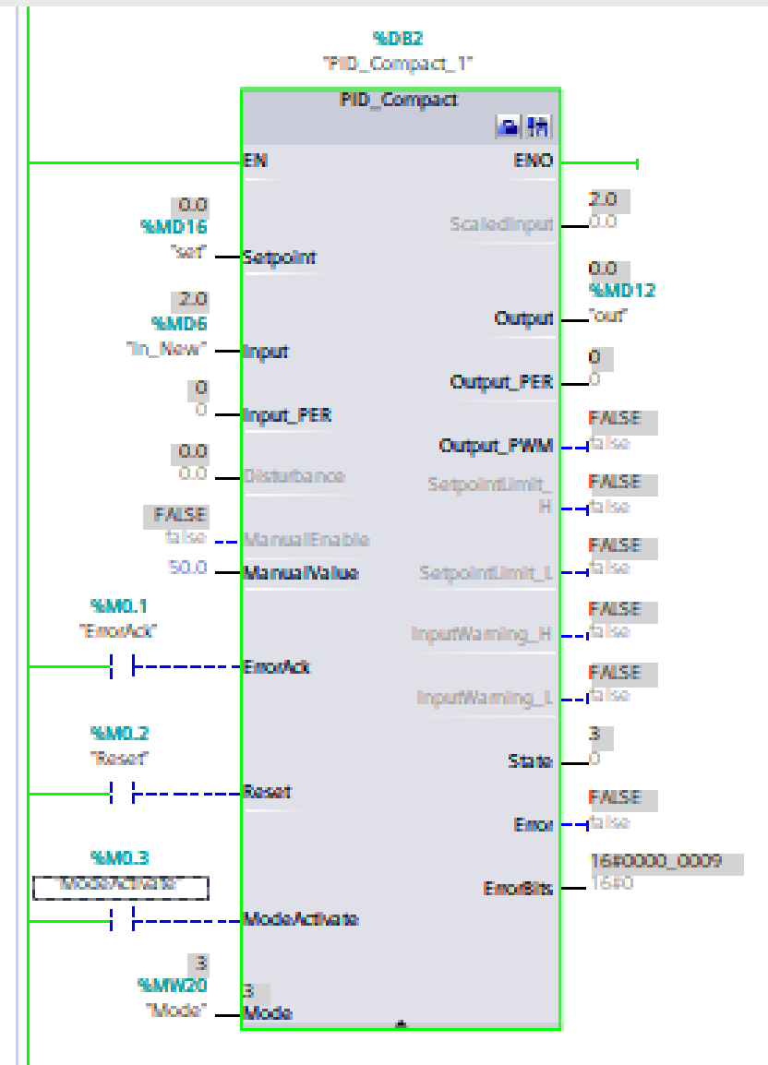

Slide 15
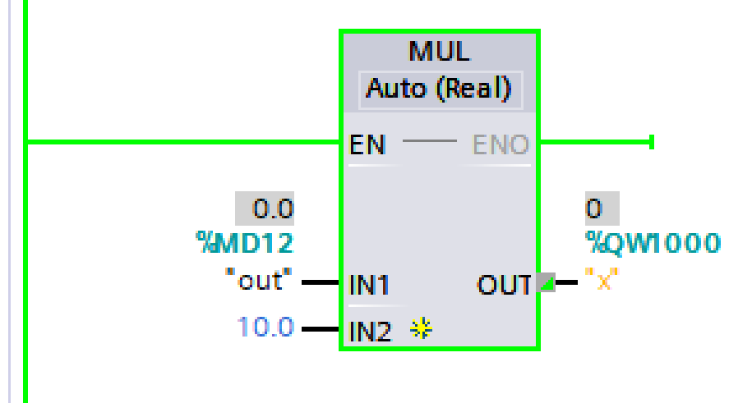
Scale of Output Pulse

Slide 16
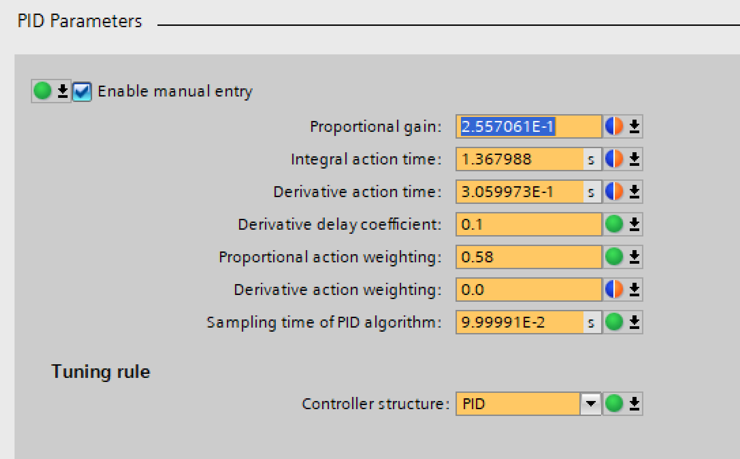
Autotuning the Speed Loop

Slide 17
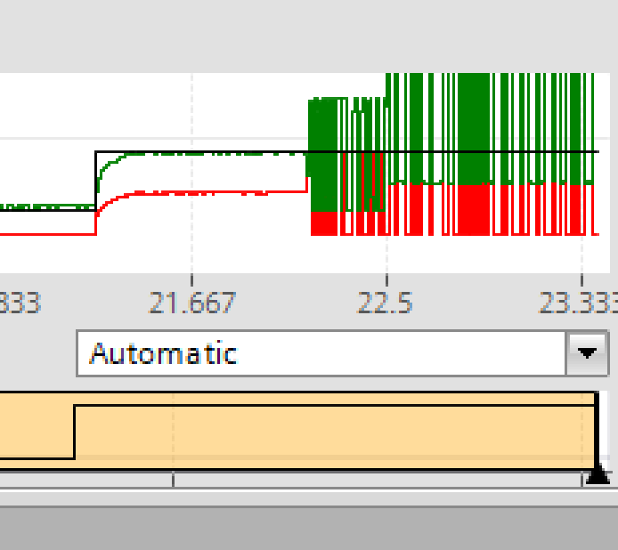
Autotune Results

Slide 18
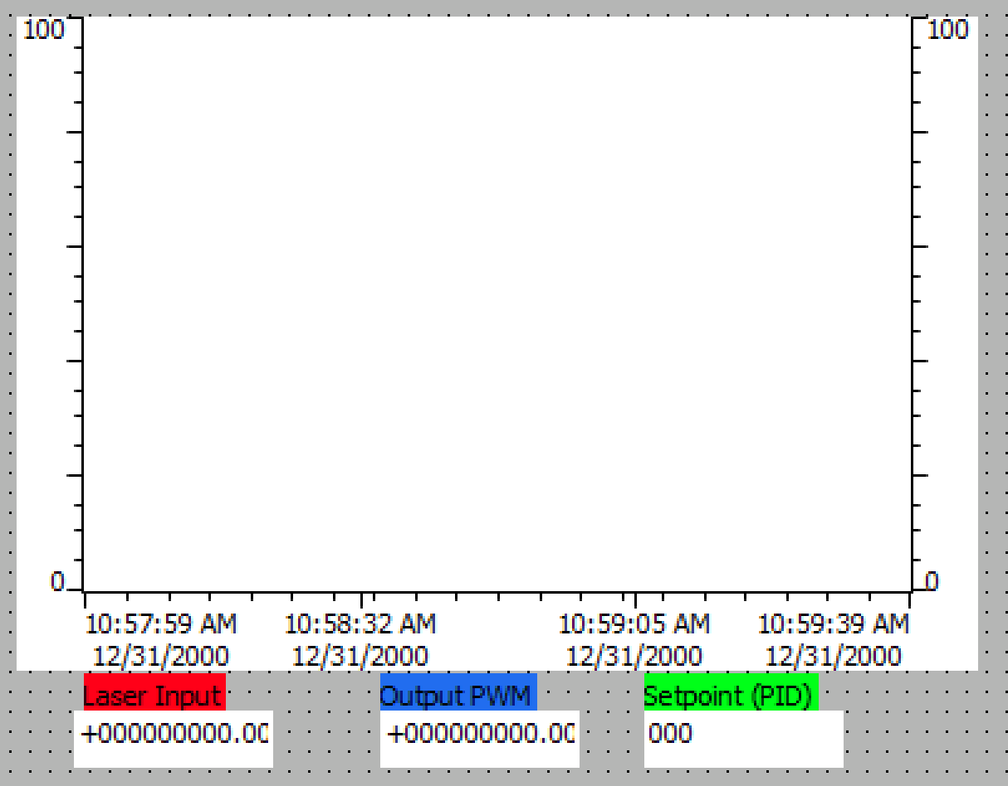
The HMI Display

Slide 19
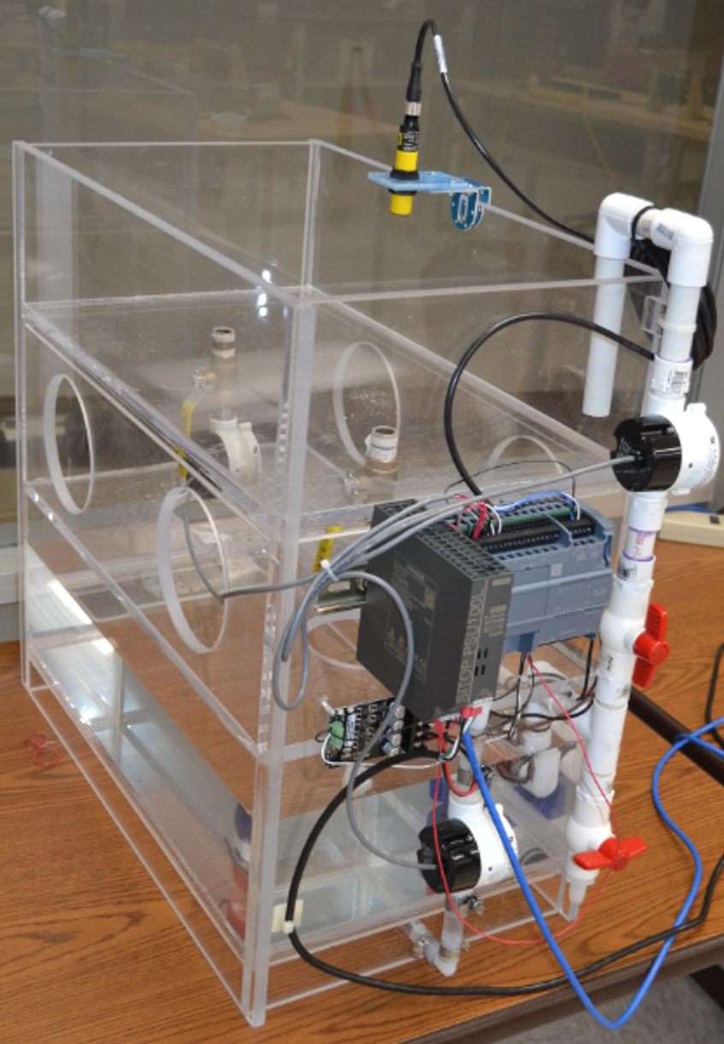

Slide 20
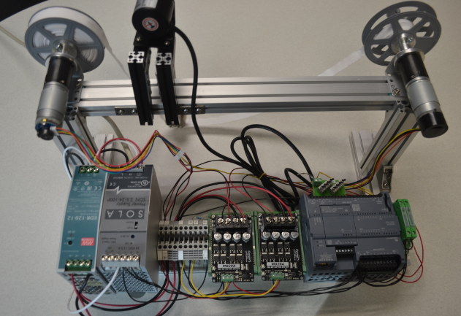

Slide 21
In summary, the motor provides a good low cost PID lab experience if the PLC is already part of the controls lab. In this case, the Siemens S7-1200 is available and suitable for this application. The tuning of the motor is the only problem in that stability issues arise which must be dealt with. The output of the PID block can be observed in a graphical form and various setpoints can be entered.

Slide 22
The ramping from setpoint to setpoint can be implemented with a small program to provide ramping of the setpoint. In all, this lab experience should provide a meaningful experience for students in an auto controls class. The lab should be robust enough to allow students to experiment with various parameters without destroying the equipment. It should be a good lab for many years to come.

Slide 23
Questions????????
Website:
hybridplc.org
Youtube channel can be accessed via ‘videos’ at top of website page
Two texts at website (free):
Hybrid Text
Hybrid Lab Text

