Slide 1
EET 4450 - Automatic Control Systems
Syllabus
Personal Intro
Why study this? http://www.youtube.com/watch?v=j-zczJXSxnw

Slide 2
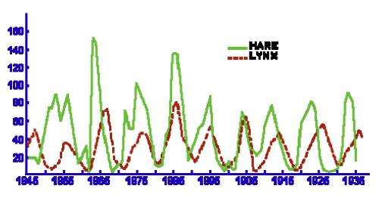
Where else?

Slide 3
Predator Prey Model
Volterra – Lotke model
  Vito Volterra and Alfred J. Lotke independently developed this useful model
  Explains the growth of a thing that depends on the growth of another thing
  Lynx and hares or whales and krill are typically used to demonstrate the model but it could be two infantry units fighting each other or two stock firms trying to acquire the same limited commodity
Let x(t) represent the prey (hares, krill, xth Inf, etc.) and y(t) represent the predator (lynx, whales, nth Inf, etc.)
Prey population growth rate without predators is assumed proportional to population size
But….

Slide 4
Predator Prey Model
But there are predators!
  The predators [eat, destroy, acquire…] the prey in proportion to the number of prey and predators.
  The predator population without sufficient prey dies out at a rate of
  But there are predators that are [eaten, destroyed, acquired …] that sustain the predators in proportion to both populations sizes:

Slide 5
Predator Prey Model
Model Solution
State Variables: x, y
Note the controls in this nonlinear, coupled, model
The model is
subject to
  x(t) = prey population size
  y(t) = predator population size
  a = growth rate of prey
  b = rate of prey predation
  m = death rate of predators
  n = rate of predator sustenance

Slide 6
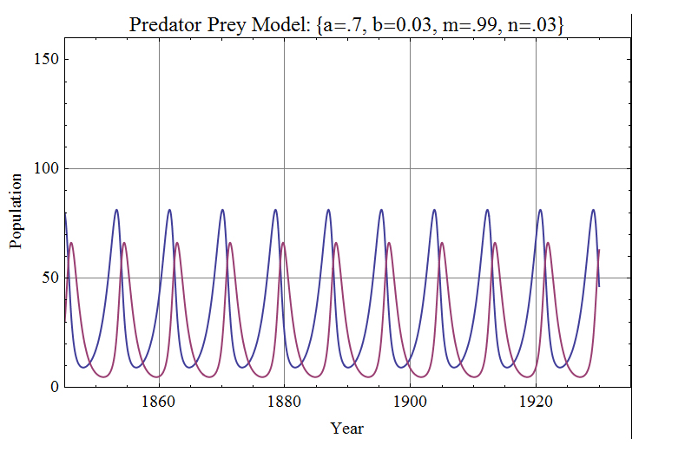
Predator Prey Model
Lynx – Hare ( data from Leigh, 1968)
Continuous Model

Slide 7
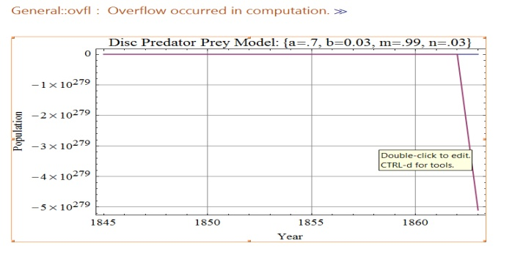
Discrete Predator Prey Model
Evaluation:
  with x(0)=80, y(0)=30
  a = 0.7, b = 0.03,
  m=0.99, n = 0.03
  Initially h = 1 year
To discretize,
  choose time step, h
  replace
  The difference equations are
  If h = 1 year, the model is

Slide 8
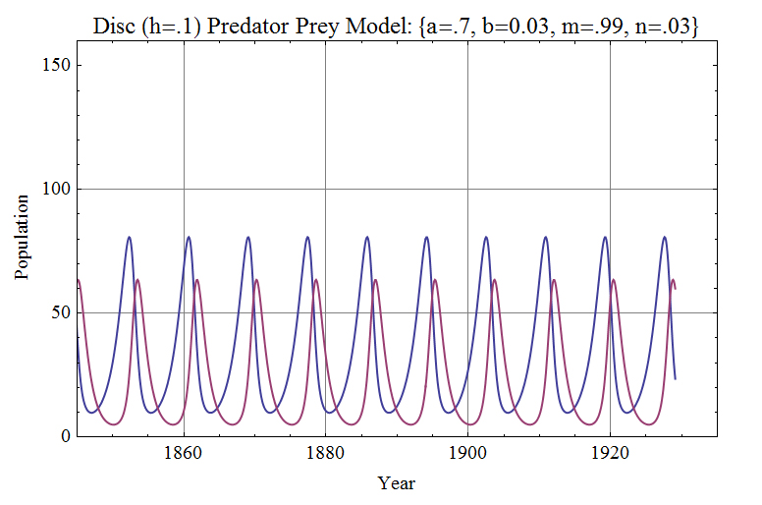
Discrete Predator Prey Model
Unstable Model!
  Problem: the time step is too big!
with h = 0.1 years
  Choice of time step
  is critical to
  discrete modeling
  The smaller the time step, the more
  accurate the model but more computations

Slide 9
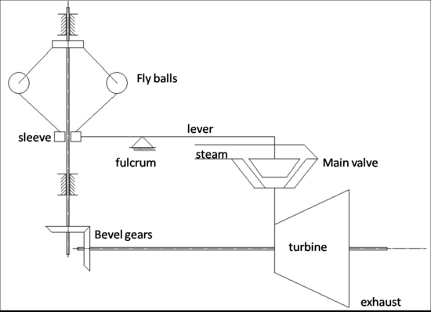
Steam Engine

Slide 10
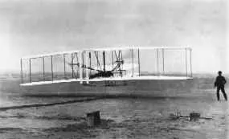
Why Airplanes Fly
Airplanes.pdf in examples folder

Slide 11
1.2 Block Diagrams and Transfer Functions
Consists of a block representing each component in a control system
P&ID – several process drawings in Liptak Handbook
The loop in a block diagram indicates fundamental concept of control – feedback – indicates closed loop control

Slide 12
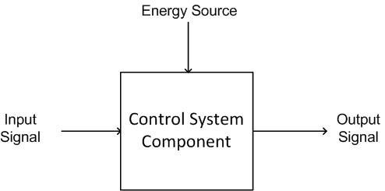
Block representation of a component

Slide 13
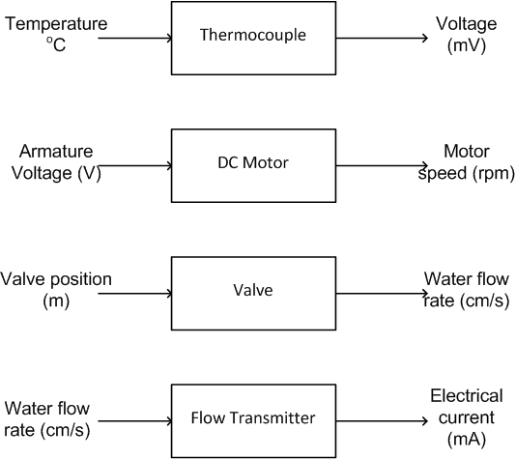

Slide 14
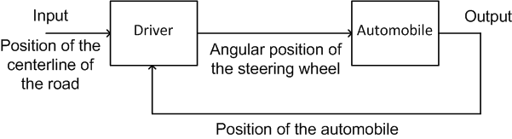

Slide 15
Transfer Function
Gain
Phase
Use Laplace Transform to calculate transfer function if necessary

Slide 16
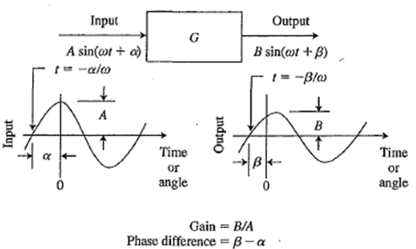
Gain and phase difference of a linear component

Slide 17
The input to a linear control system component is a 0.5 Hz sinusoidal signal with a peak amplitude of 5.3 V and a phase angle of 30º. The output of the component has a peak amplitude of 14 mA and a phase angle of 25º. Determine the gain, the phase difference, and the transfer function for these conditions.
Gain = 14 mA/5.3V = 2.64 mA/V
Phase difference = 25 – 30 = -5º
Transfer function = 2.64 /-5º mA/V

Slide 18
Y=mX+b
Determine m
  Use: m= $\frac{∆ Y}{∆X}$ = $\frac{Y₂−Y₁}{X₂−X₁ }$
Pick one point and insert the X and Y values
Determine b by calculation (algebra)
Write Y=mX+b using the calculated values

Slide 19
Instrument example
A temperature measuring transmitter has an input range from -40° to 60° C and an output range from 4 to 20 mA. Assume the transmitter is linear and find the following:
The slope of the gain constant (m)
The y axis intercept (b)
The equation for the line (Y=mX+b)
The output of the transmitter when the input is 22° C
The input to the transmitter when the output is 11 mA

Slide 20
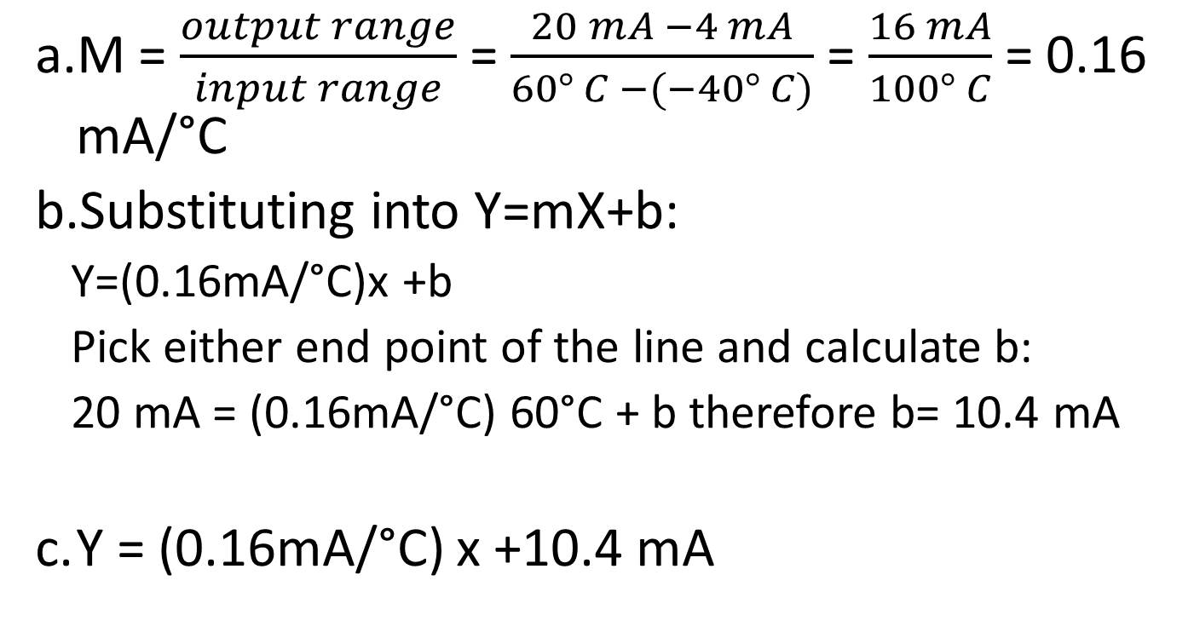
Instrument example
M = $\frac{output range}{input range}$ = $\frac{20 mA −4 mA}{60° C −(−40° C)}$ = $\frac{16 mA}{100° C}$ = 0.16 mA/°C
Substituting into Y=mX+b:
  Y=(0.16mA/°C)x +b
  Pick either end point of the line and calculate b:
  20 mA = (0.16mA/°C) 60°C + b therefore b= 10.4 mA
Y = (0.16mA/°C) x +10.4 mA

Slide 21
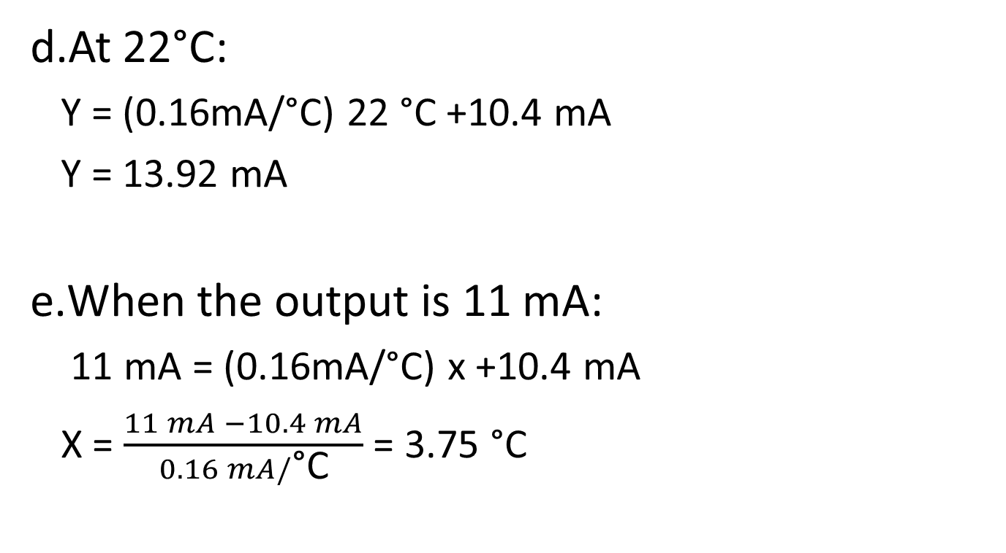
Instrument example
At 22°C:
  Y = (0.16mA/°C) 22 °C +10.4 mA
  Y = 13.92 mA
When the output is 11 mA:
  11 mA = (0.16mA/°C) x +10.4 mA
  X = $\frac{11 mA −10.4 mA}{0.16 mA/\text{°}\text{C}}$ = 3.75 °C

Slide 22
Y=mX+b
A level measuring transmitter has a linear input/output. The input range is 5.0 to 10.0 meters, and the output range is 3 to 15 psi.
What is the output when the input is 6.3 m?
What is the input when the output is 9.1 psi?

Slide 23
Level Transmitter
m = 12/5 = 2.4 psi/m
b = -9 psi
When input = 6.3 m, find the output
When the output is 9.1 psi, find the input

Slide 24
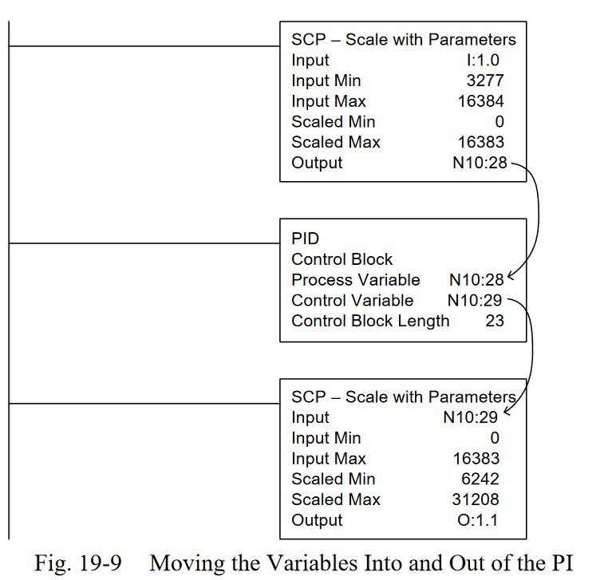
Old A-B
Other Approaches to linearization

Slide 25
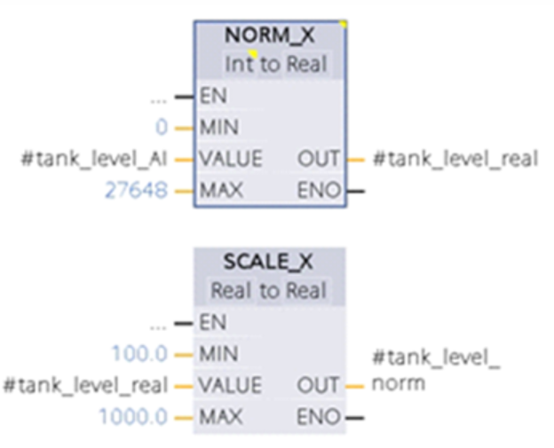
NORM_X reduces a number across arrange from a min to a max to a number ranging from 0 to 1
SCALE_X takes the number in NORM_X and ratios it to a number from MIN to MAX
Siemens -Other Approaches to linearization

Slide 26
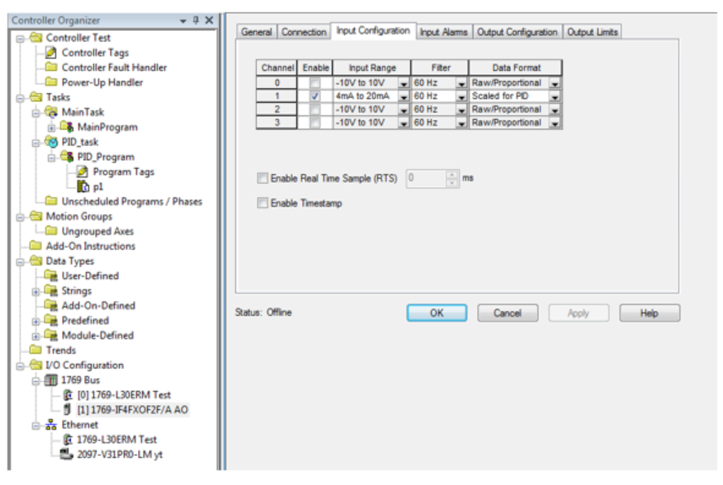
New A-B Approach – The low and high range is set as well as the output low and high when the card is configured that is being added.

Slide 27
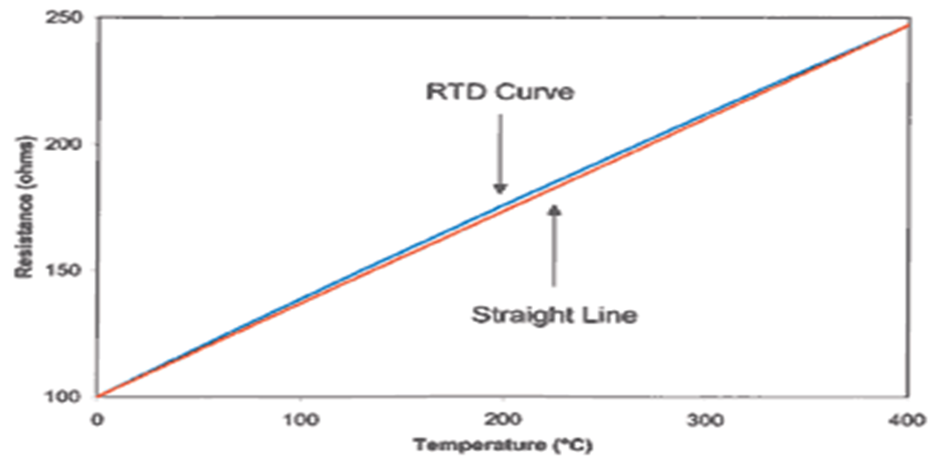
Most Sensors will be Linear

Slide 28
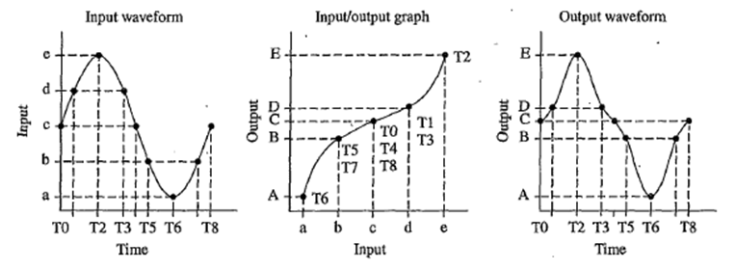
NONLINEARITIES

Slide 29
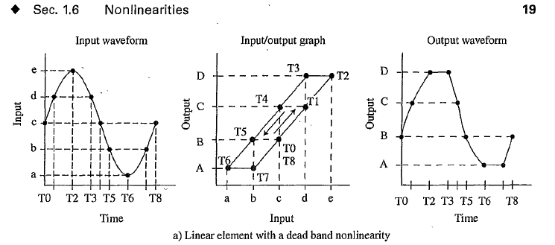
Dead band is the range of values through which an input can be changed without producing an observable change in the output.
The dead-band effect occurs whenever the input changes direction.
Backlash in gears is one example of dead band and the term backlash is sometimes used in place of dead band.

Slide 30
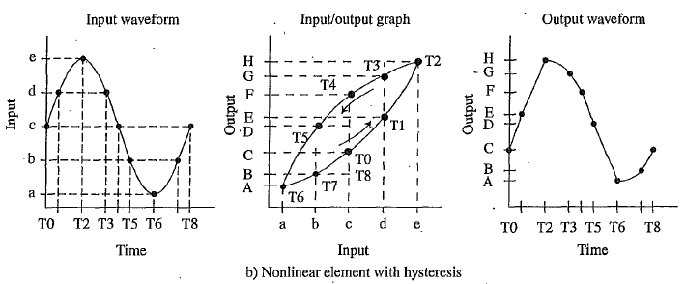
Hysteresis occurs when the I/O graph follows different curved paths when the input increases and decreases.
Notice the distortion in the output graph compared to the input graph

Slide 31
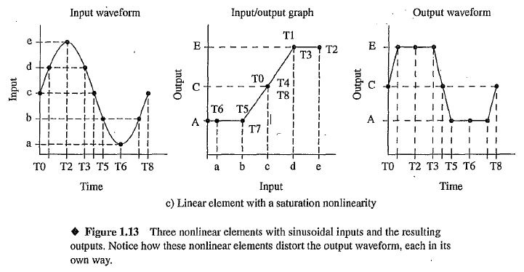
Saturation refers to the limitations of the range of the values for the output of a component.

Slide 32
PID/P&ID
PID – a Controller with a Proportional, Integral and Derivative component
P&ID – a Drawing setting up the control of a process.
- Process and Instrumentation Drawing
- Piping and Instrumentation Drawing
This drawing may be a conceptual only drawing used to purchase instruments and program devices or it may also be used to bid the construction of the process with information about location and type of devices involved.

Slide 33
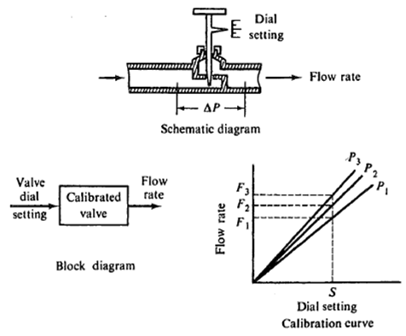
Open Loop Control
A calibrated needle valve is an example of an open-loop system

Slide 34
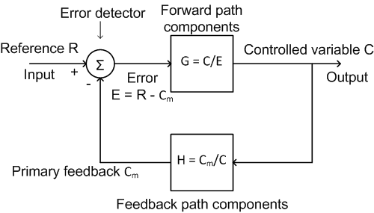
Block diagram of a closed loop servo control system

Slide 35
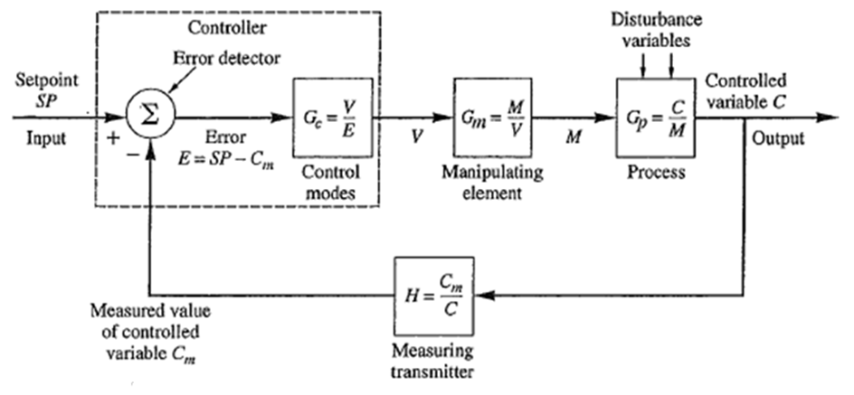
Block diagram of a closed-loop process control system

Slide 36
Variable Names
The controlled variable (C) is the process variable that is controlled. Examples are position, velocity, temperature, pressure, level, flow rate (also C_{v})
Setpoint (SP) is the desired value of the controlled variable
Measured Variable (C_{m}) is the measured variable (also PV)
Error is the difference between SP and C_{m}
_{That is: E = SP – PV}
_{or E = PV - SP}

Slide 37
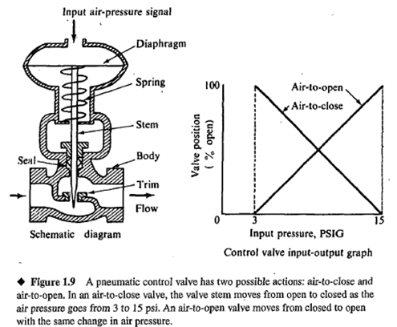
Why???

Slide 38
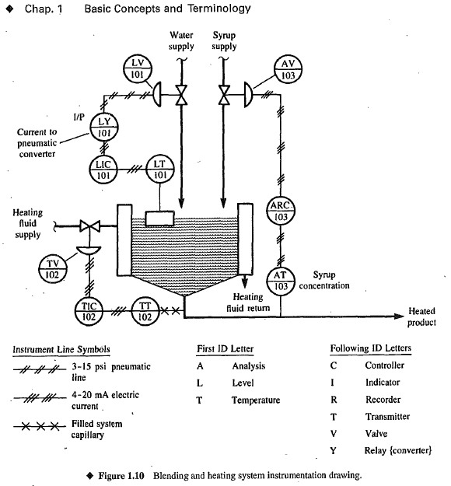
Control System Drawings
Example P&ID
Process and Instrumentation Diagram

Slide 39
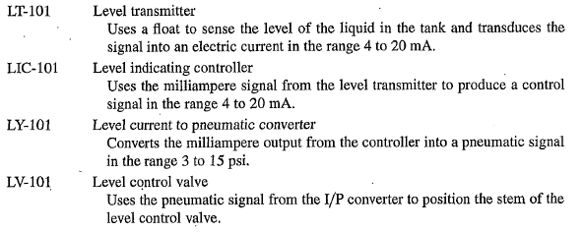
The circles are not ‘circles’. They are called ‘bubbles’. The letter designations inside have meaning. Here are some from the prior figure>

Slide 40
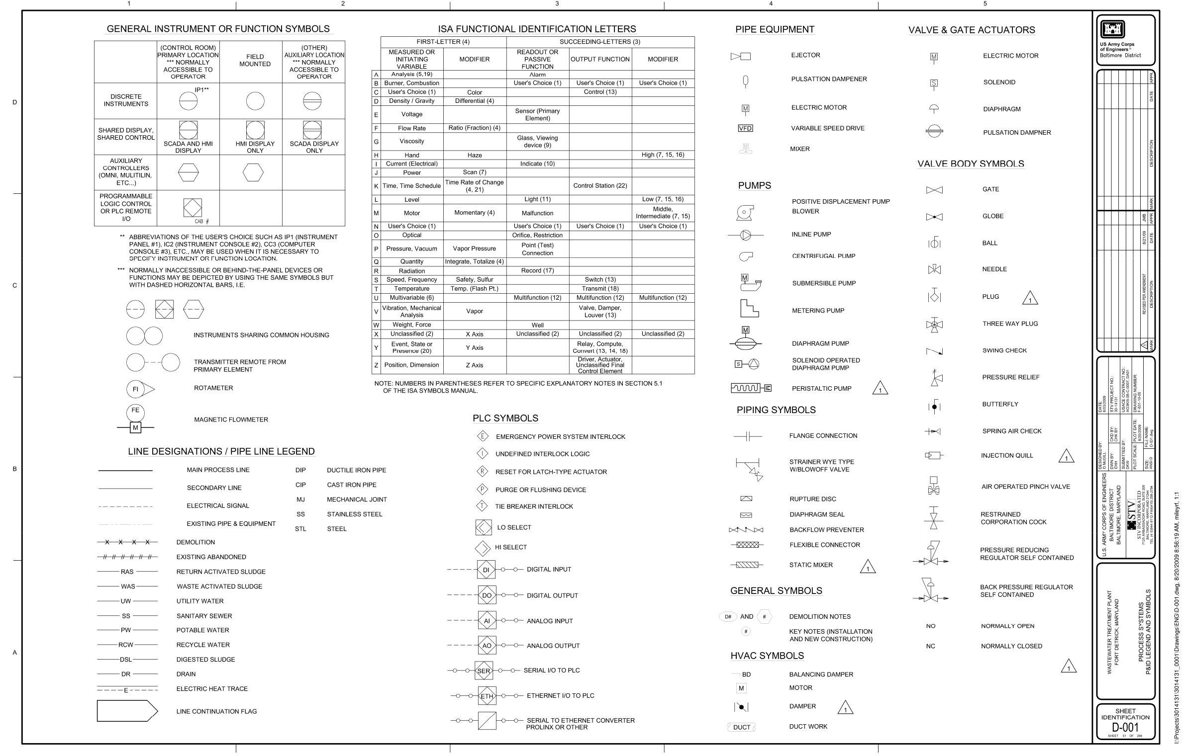
Example P&ID from hybridplc.org website

Slide 41
P & ID Provide
All the equipment, including installed spares, and associated piping including drain and vent line.
Insulation or jacketing requirements.
Instrumentation
Heat tracing and insulation detail
Information about utilities
Piping components including their size, class and tag Number
Information required for design, construction, and operation such as a slope of the line
Minimum and maximum distance from the equipment or instruments
Minimum straight lengths after instruments

Slide 42
P & ID Does Not Provide
Process conditions and physical data
Operating conditions
Streamflow details
Equipment locations
Pipe routing, length, and fittings
Support and structural details

Slide 43
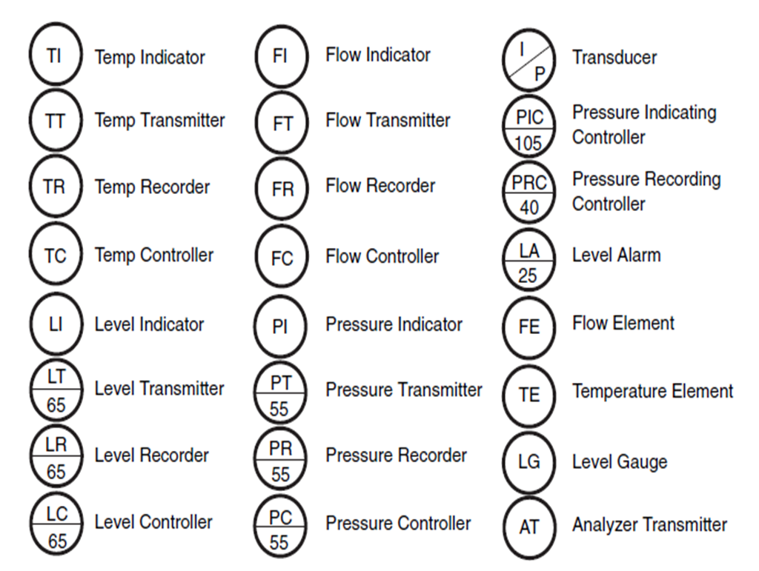
See Detailed List of Meanings of Devices in Ch. 19 of Hybrid Text pg 83-86

Slide 44
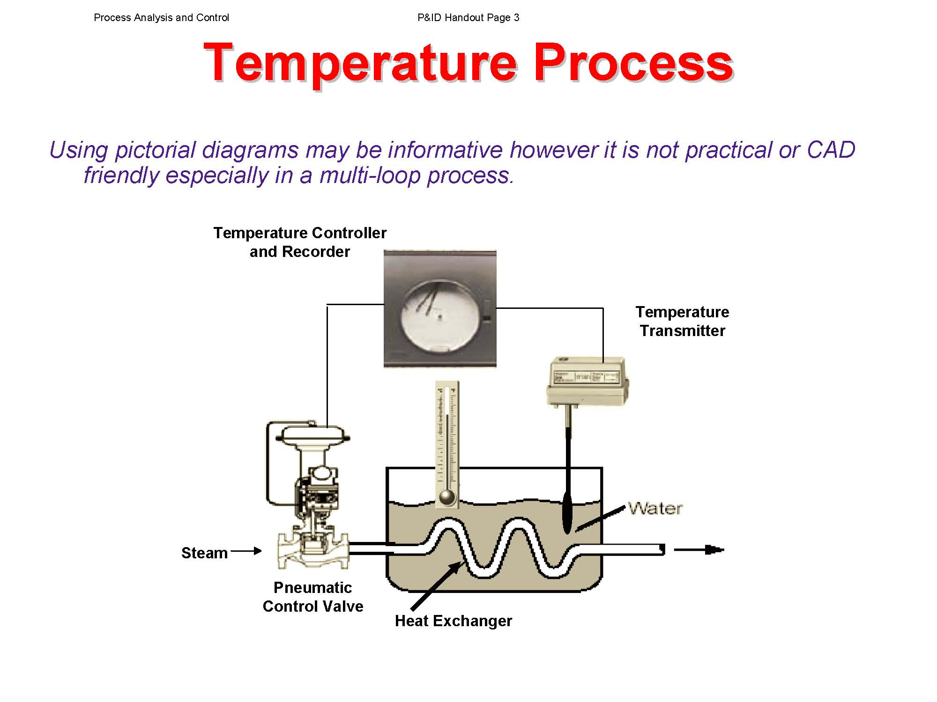

Slide 45
The reference R is the input to the servo control system and the controlled variable (C) is the output.
We now proceed to derive the transfer function, C/R, of the closed loop servo control system. First, we write the equation for the output of the error detector in terms of reference, R, and the primary feedback, C_{m}.
E = R – C_{m}
E = SP – PV

Slide 46
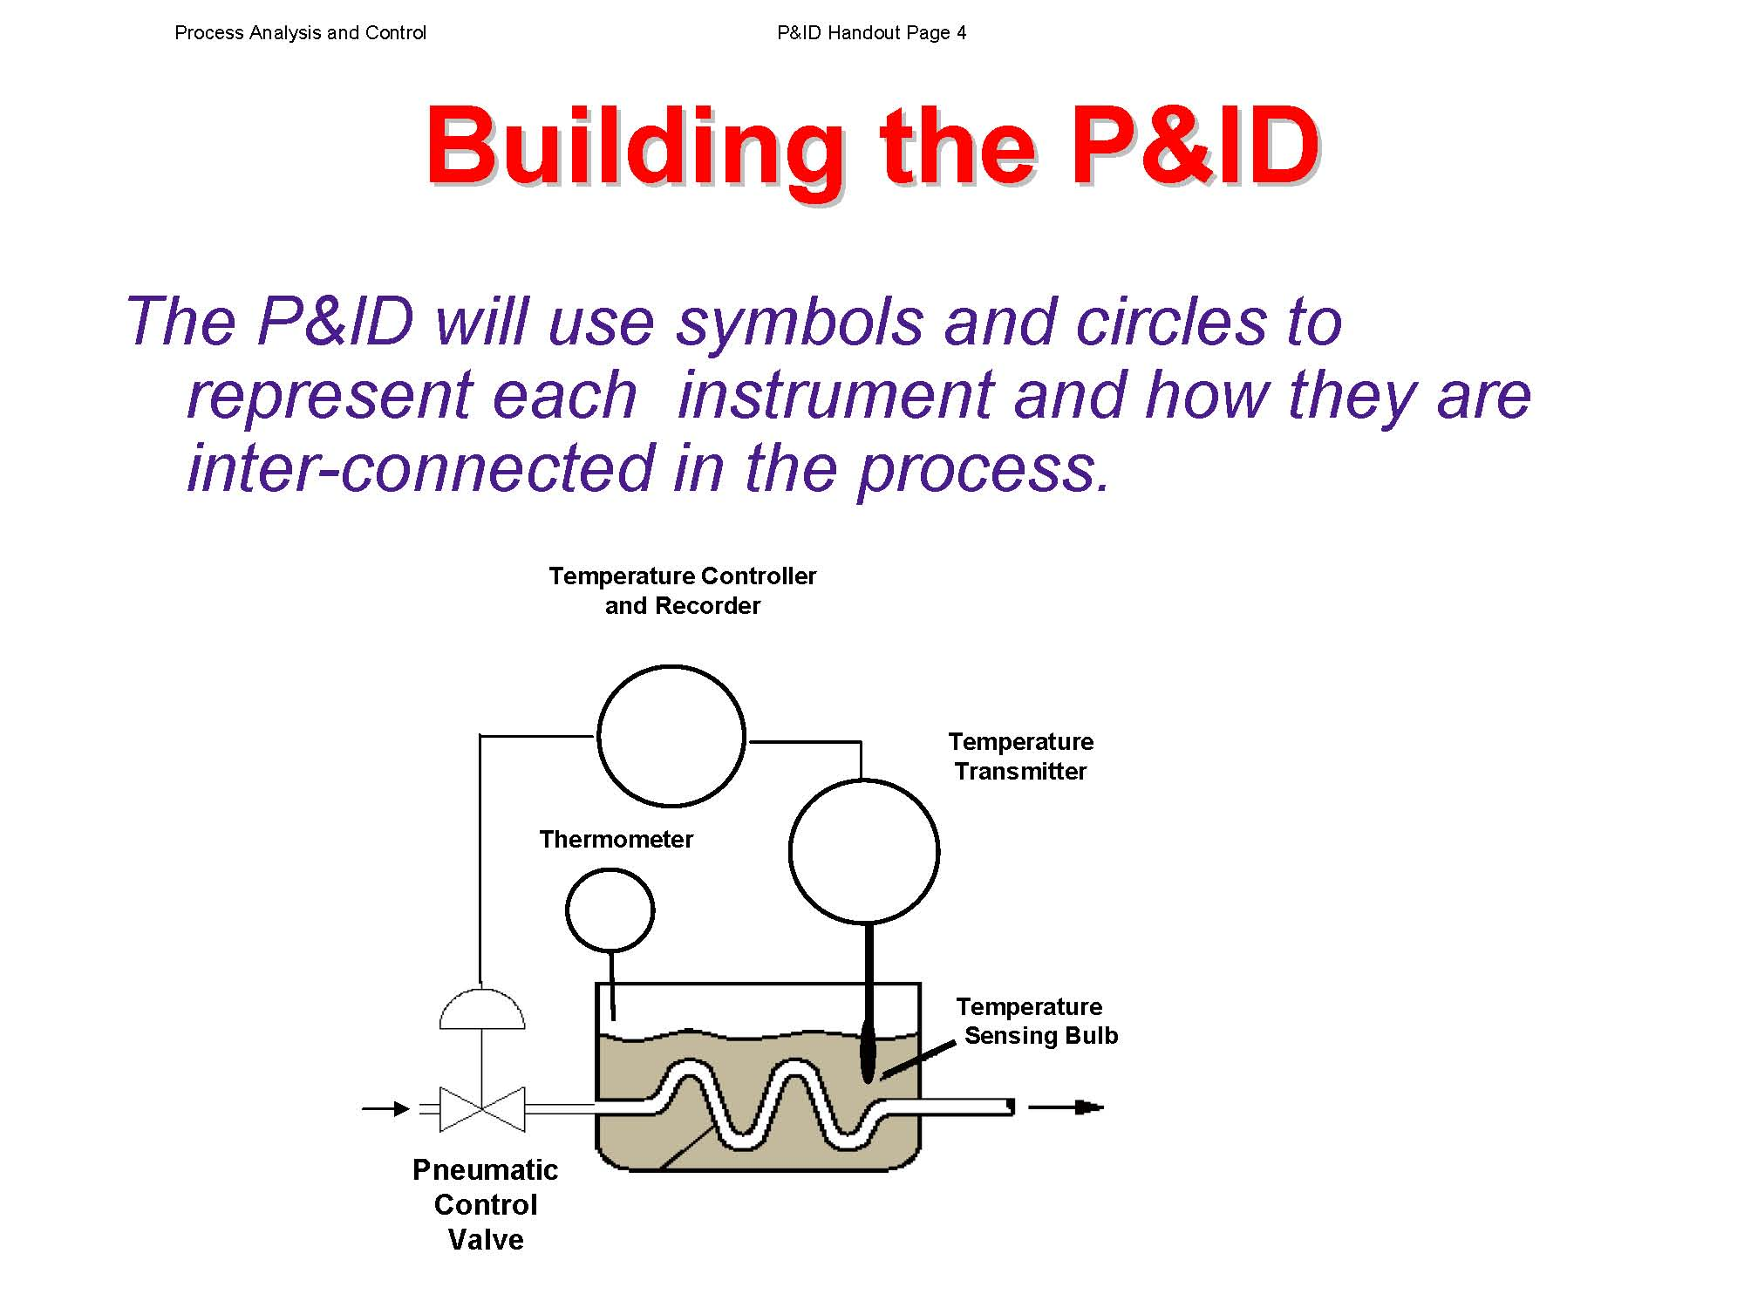

Slide 47
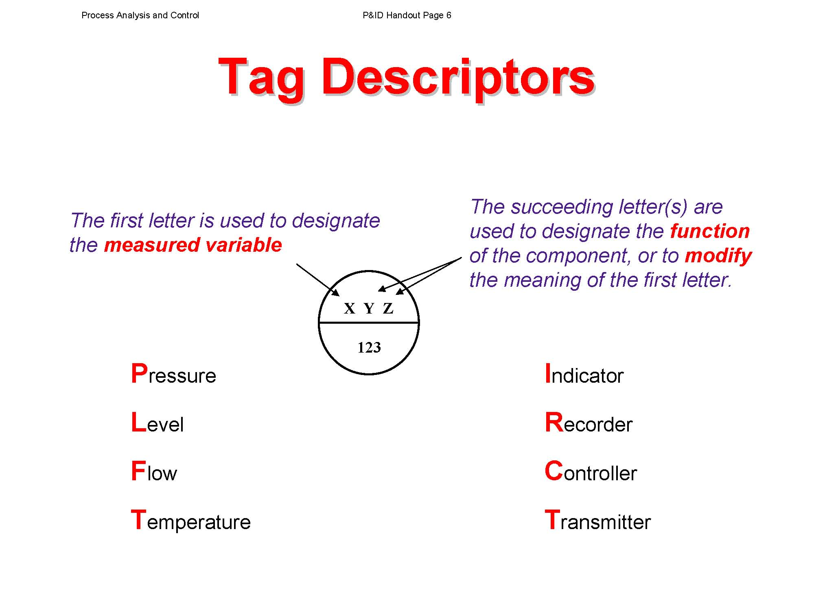

Slide 48
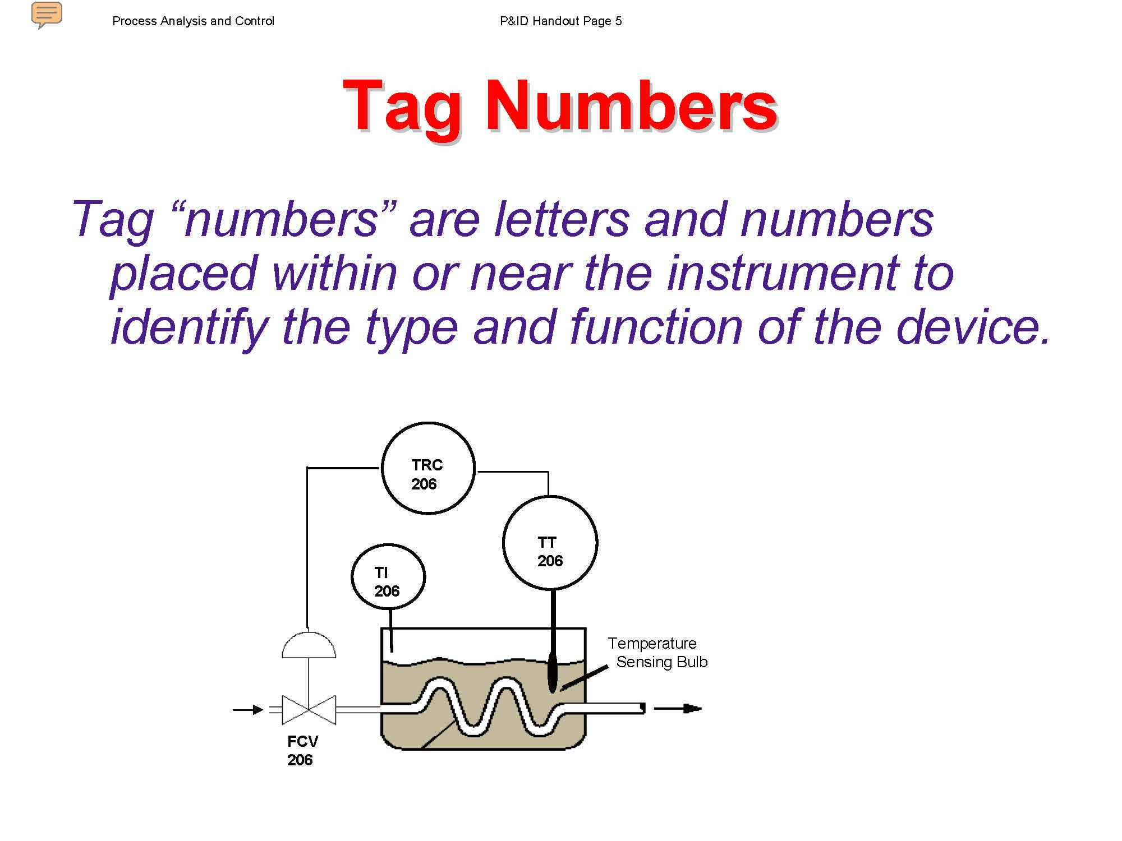

Slide 49
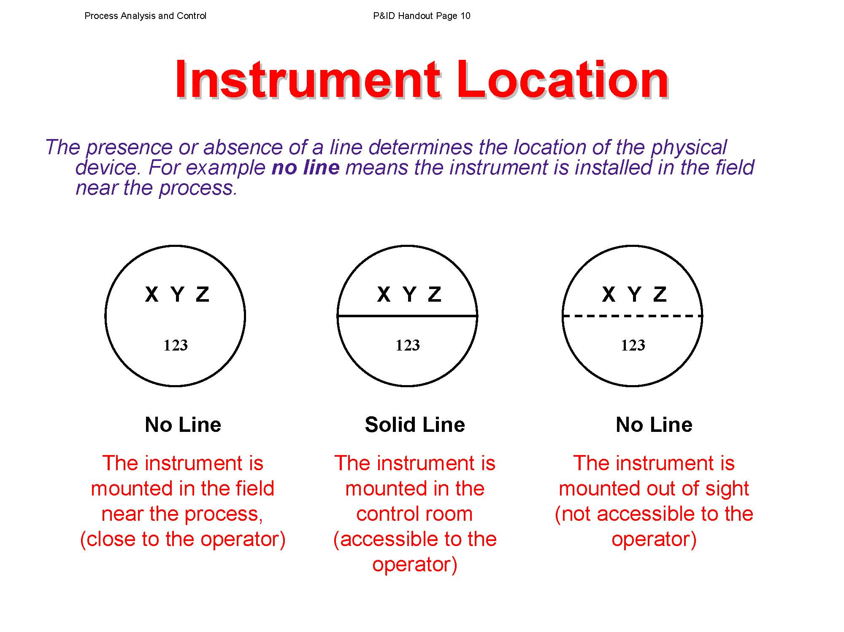

Slide 50
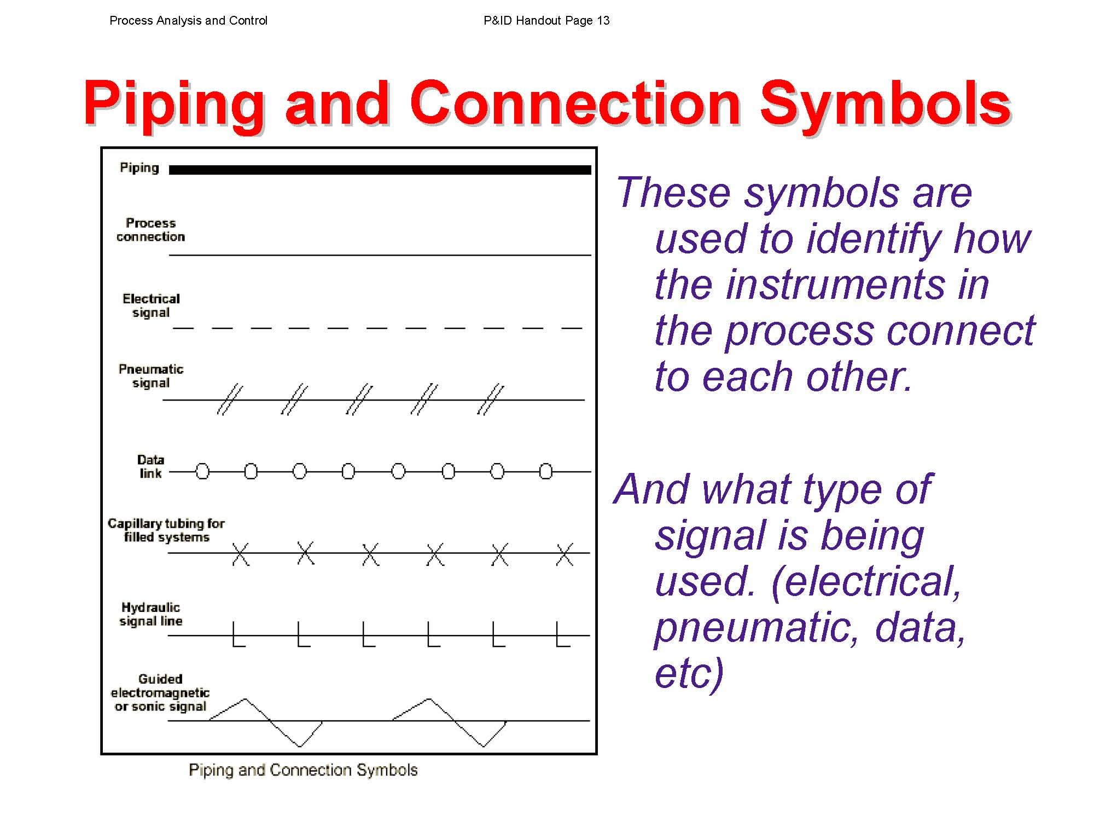

Slide 51
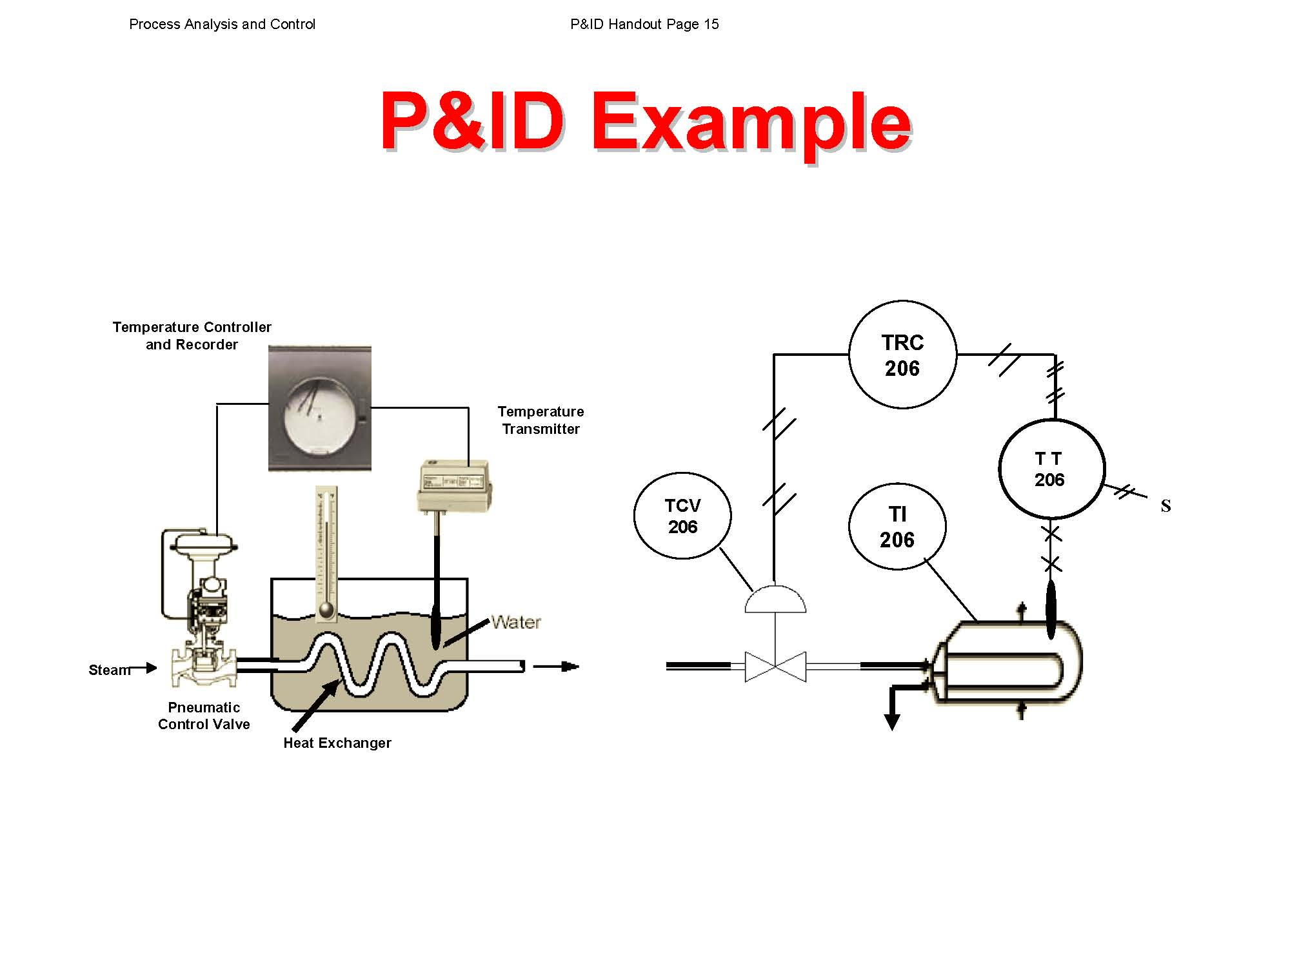

Slide 53
Either a controller with _IC or _RC equates to a PID Controller with two inputs and one output.

Slide 54
Either the controller has two inputs and one output or

Slide 55
The controller has one input and output. Where does the SP come from? It comes from the Operator Panel or Computer screen.

Slide 56
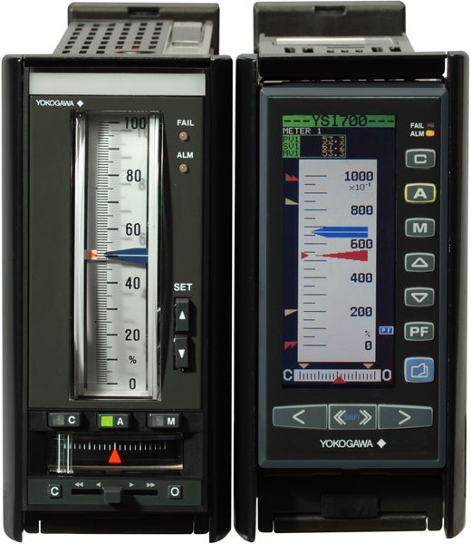
Automatic and Manual Control

Slide 57
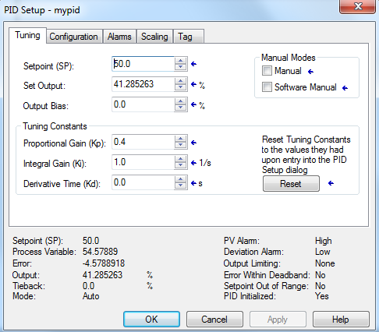
Inside a PID Block

Slide 58
Outside a PID Block – the Face Plate

Slide 59
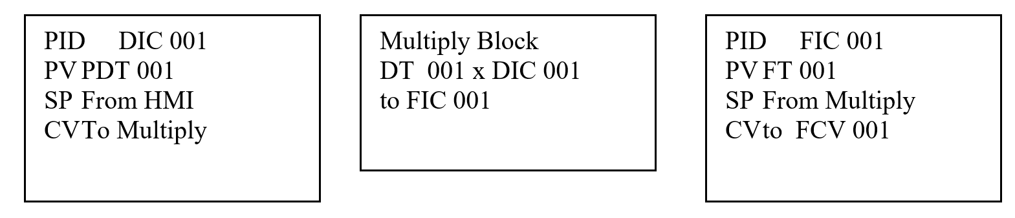
Simple Box Representation of PID Control

Slide 60
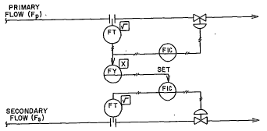
Use the example above to create simple control of the following:

Slide 61
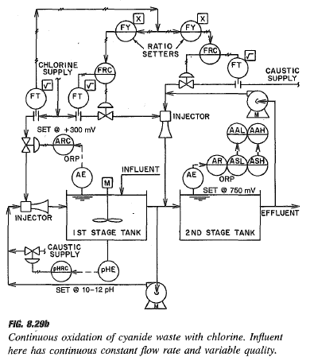
Use the example above to create simple control of the figure at left:

Slide 62
Benefits of Automatic Control
Increased productivity
Improved quality and uniformity
Increased efficiency
Power assistance
Safety
Comfort and convenience
Kaufman
https://www.youtube.com/watch?v=eXB2qHsVsfM&list=PLj10k9JPIMAGPAIylqEkEr-oGKIMQPsge

Slide 63
Load Changes
The load on a control system is measured by the value of the manipulated variable required by the process at any one time in order to maintain a balanced condition
A change in demand by the controlled medium
A change in the quality of the manipulated variable
A change in ambient conditions
A change in the amount of energy absorbed or supplied

Slide 64
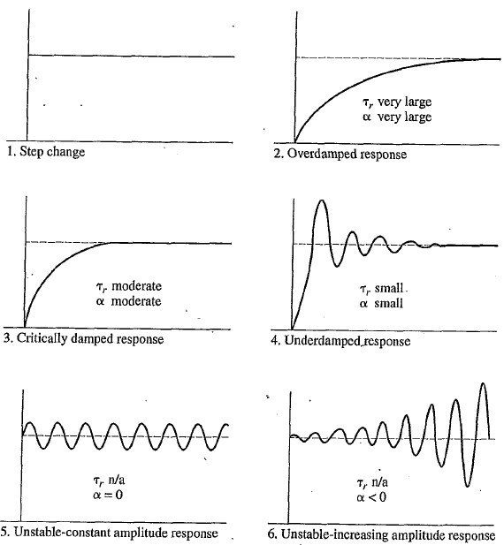
Damping and Instability

Slide 65
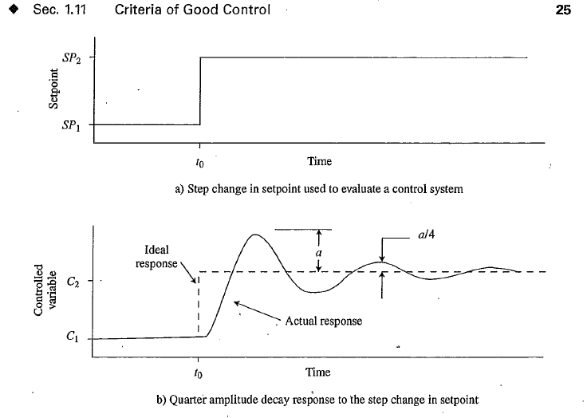

Slide 66
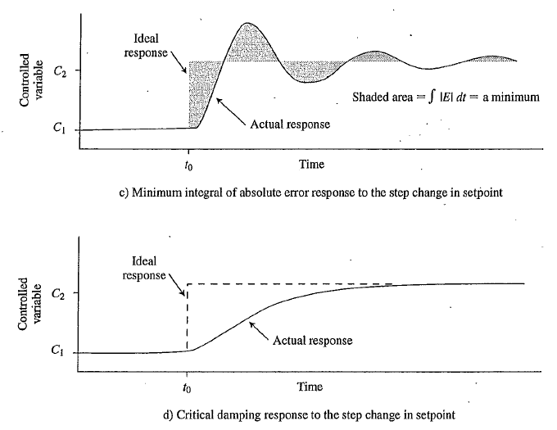

Slide 67
Classification of Control Systems
1. Feedback
a. not used – open loop
b. used – closed loop
2. Type of Signal
  a. continuous
  b. discrete

Slide 68
Open- and Closed-Loop Control
Consider two alternative ways of heating a room to some required temperature. In the first instance, there is an space heater which has a selection switch which allows a 1 kW or a 2 kW heating element to be selected. The user selects the required heating element. The room will heat up and reach a temperature based on the power of the heating element selected. The temperature of the room is thus controlled by an initial decision and no further adjustments are made. This is an example of open-loop control. If there are changes in the conditions, perhaps someone opening a window, no adjustments are made to the heat output from the space heater to compensate for the change. There is no information fed back to the space heater to adjust it and maintain a constant temperature.
Notes:
Stop light
at night
Setting of a lawn sprinkler

Slide 69
Closed Loop Control System
Now consider a different space heating system. To obtain the required temperature, a thermometer input to the controller switches the 1 kW and 2 kW elements on or off, according to the difference between the actual room temperature and the required temperature in order to maintain the temperature of the room at the required temperature. There is a constant comparison of the actual and required temperatures. In this situation there is feedback, information being fed back from the output to modify the input to the system. Thus if a window is opened and there is a sudden cold blast of air, the feedback signal changes because the room temperature changes and so is fed back to modify the input to the system. This type of system is called closed loop. The input to the heating process depends on the deviation of the actual temperature fed back from the output of the system from the required temperature initially set. This difference we will call ERROR.

Slide 70
Error
Note that the comparison element in the closed-loop control system is represented by a circular symbol with a + opposite the set value input and a − opposite the feedback signal. The circle represents a summing unit and what we have is the sum.
Set value - Feedback value = error
This difference between the set value and feedback value, the so-called error, is the signal used to control the process. If there is a difference between the signals then the actual output is not the same as the desired output. When the actual output is the same as the required output then there is zero error. Because the feedback signal is subtracted from the set value signal, the system is said to have negative feedback.

Slide 71
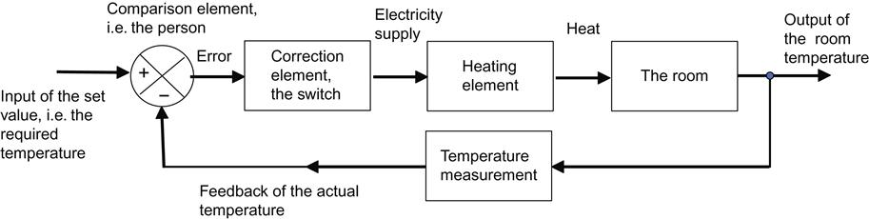
Example of Closed Loop Control
Notes:
Draw this an elaborate on each part

Slide 72
Classification of Control Systems
Industry
  a. Processing – process control
        Continuous systems
        Batch systems
    b. Discrete-part manufacturing
    1. numerical control
    2. robotic control

Slide 73
Process Controller - Introduction
Process controllers are control system components which basically have an input of the error signal, i.e. the difference between the required value signal and the feedback signal, and an output of a signal to modify the system output. The ways in which such controllers react to error changes are termed the control modes.
The simplest form of controller is an on–off device which switches on some correcting device when there is an error and switches it off when the error ceases. Although simple, such a method of control has limitations and often more sophisticated controllers are used.
While there are many ways a controller could be designed to react to an error signal, a form of controller which can give satisfactory control in a wide number of situations is the three-term or PID controller. The three basic control modes are proportional (P), integral (I) and derivative (D); the three-term controller is a combination of all three modes.

Slide 74
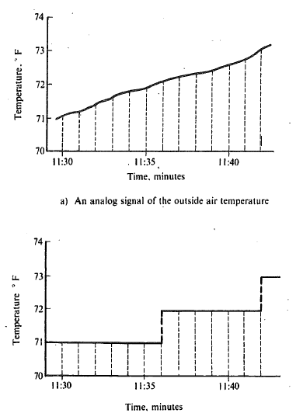
Analog and Digital

Slide 75
Regulator and Follow-up Systems
Control systems are classified as regulator or follow-up systems, depending on how they are used
A regulator system is a feedback system in which the setpoint is seldom changed
A follow-up control system maintains the control variable at a changing setpoint.

Slide 76
Process Control
Choice of control modes: P, I, PI, PD, PID
Detects and annunciates alarms
Accepts several analog inputs (above four)
Accepts several digital inputs (three or four)
Provides more than one analog output
Provides several digital outputs
Direct input from thermocouple or RTD
Linearizes thermocouple inputs

Slide 77
Process Control
Performs ratio, feedforward or cascade control
Bumpless transfer between automatic and manual modes
Bumpless transfer between local and remote modes
Front panel configuration of the controller
Adaptive gain (automatic adjustment of the proportional mode gain

Slide 78
Process Control
Self-tuning by process model – determination of the control mode parameters from the model that is formed from observation of the response to step change
Self-tuning by pattern recognition – automatic adjustment of the control mode patterns after a disturbance by scanning the recovery pattern and applying tuning rules

Slide 79
Process Control
Self-diagnostics – automatic detection and annunciation of certain types of failure
Mathematical operations such as addition, subtraction, multiplication and square root
Digital communication with supervisory control computer

Slide 80
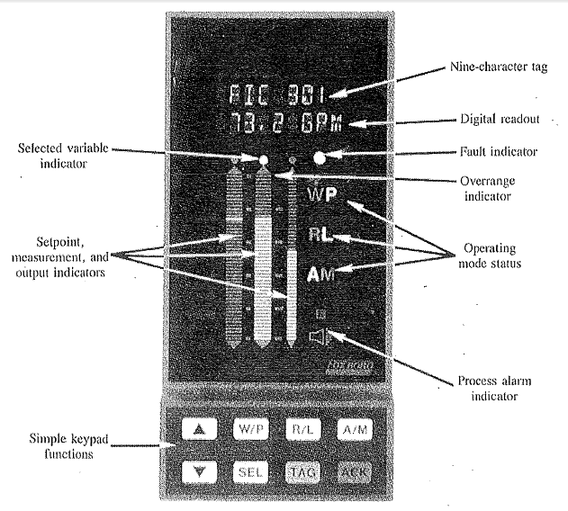

Slide 81
Laplace

Slide 82
Laplace Transforms and Transfer Functions
Introduction 4.1
Any component that has capacitance, inertia, inertance or inductance will require derivative and/or integral terms to describe the relationship between its input and output.
Do we need calculus to study such components?
Not necessarily
In fact, you may be amazed at how much you can learn about control systems using algebraic methods and complex numbers.

Slide 83
You will be able to answer questions such as :
How does this component respond to inputs of different frequencies
or
What is the frequency limit of this follow-up control system
or
How can we design this control system to have the fastest possible response without being unstable

Slide 84
Time Domain
Frequency Domain
Laplace Transform
Differential Equations
Input q(t)
Output h(t)
Algebraic Equations
Input Q(s)
Output H(s)
Inverse
Laplace Transform

Slide 85
The Need for Frequency Domain
Human Ear:
If you look at an oscilloscope showing the output from a microphone, it is very difficult to distinguish similar-sounding words. Even when this time-domain waveform is digitized and a computer is used, it is still difficult to differentiate between similar-sounding words. However, if a FFT is applied, the computer can more easily discriminate between words. The cochlea (spiral-shaped part of the inner ear) performs this function in human hearing.

Slide 86
Soldiers who operated artillery in WW I had hearing damage. Autopsies of these soldiers revealed that certain cilia inside the cochlea were destroyed. The hearing damage that a noisy environment can cause is a well-documented fact and the use of hearing protection is wise and required in most such situations.
(FFT – Fast Fourier Transform)

Slide 87
Vibration of a Motor:
As a motor starts to wear out, be bearing noise increases. By the time a trained observer can hear the noise, the motor is in very bad shape. An oscilloscope view of the waveform is no better at picking up the bearing noise. However, a preventative maintenance procedure using an accelerometer can show the amplitude of higher-frequency noise again using the FFT. When used, this diagnostic tool can help with the repair of motors before extensive damage occurs.

Slide 88
What is a Fourier Transform?
https://www.youtube.com/watch?v=wmCIrpLBFds

Slide 89
Self Regulating Liquid Tank
Consider the self-regulating liquid tank in Figure 4.1. The liquid level in the tank remains constant when the flow rate (q_{in}) is equal to the outflow rate (q_{out}). If the inflow rate is greater than the outflow rate, the liquid level will rise. If the inflow rate is less than the outflow rate, the level will fall. During a certain time interval (∆t), the amount of liquid in the tank will change by an amount (∆V) equal to the average difference between the inflow rate and the outflow rate multiplied by (∆t).
∆V = (q_{in} - q_{out})_{avg} ∆t, m³

Slide 90
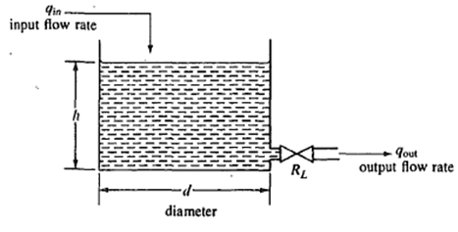
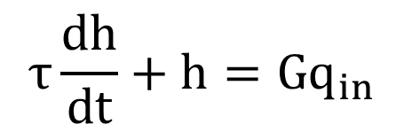
$$τ\frac{dh}{dt}+h=Gq_{in}$$

Slide 91
A self-regulating liquid tank has a restriction with resistance R_{L} at the outlet of the tank. If the liquid level in the tank increases, the flow through the restriction also increases. If the level decreases, the flow through the restriction decreases. As long as the tank is not full, the level will automatically adjust until the outflow equals the inflow.

Slide 92
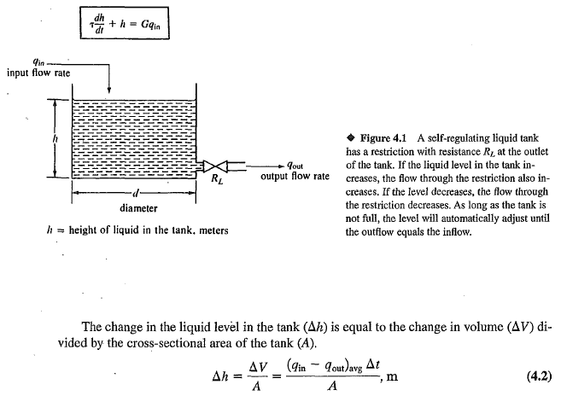

Slide 93
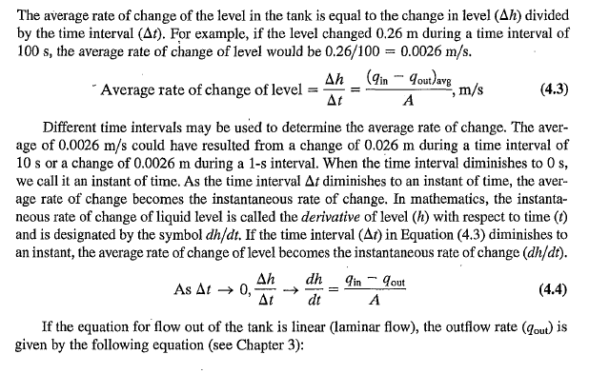

Slide 94


Slide 95


Slide 96


Slide 97


Slide 98


Slide 99


Slide 100


Slide 101


Slide 102


Slide 103


Slide 105
Operational Laplace Transforms
Operational transforms provide the answer to questions such as: What is the Laplace transform of the sum of two or more functions when you know the transform of each function acting alone? What is the Laplace transform of the derivative or integral of a function?
The Laplace transform of the sum of two or more functions is the sum of the transform of each term taken alone.
In control systems, the usual practice is to assume that all initial conditions are zero. The transfer function is defined as the s-domain ratio of the output over the input with all initial conditions set to zero unless defined in the problem as non-zero.

Slide 106


Slide 107


Slide 108



Slide 109


Slide 110



Slide 111


Slide 112

Inverse Transforms

Slide 113


Slide 114


Slide 115


Slide 116


Slide 117



Slide 118


Slide 119



Slide 120


Slide 121


Slide 122



Slide 123


Slide 124


Slide 125
Inverse Laplace.pdf
and
Heaviside.pdf
in EET 4450 folder
Table of Laplace Transforms in Examples folder

Slide 126
Matlab

Slide 127
Introduction to MATLAB
MATLAB is in the ECC virtual labs. Its the same configuration as in the ECC computer labs.
More information can be found:
https://rocketsutoledo.sharepoint.com/sites/ecchelp/eccwiki/ENG%20Virtual%20Labs.aspx
To work with Matlab, the PPT slides show the solution to each of the problems.
You do not need to go further than copy the slides to run the problems. However, to become more familiar with the capabilities of Matlab, there are a number of good youtube videos that may be helpful.

Slide 128

Example Solutions using MATLAB

Slide 129


Slide 130


Slide 131


Slide 132


Slide 133


Slide 134
Laboratory Exercise
Simulink Modeling
Introduction: Simulink Modeling – to be done with Matlab
In Simulink, it is very straightforward to represent and then simulate a mathematical model representing a physical system. Models are represented graphically in Simulink as block diagrams. A wide array of blocks are available to the user in provided libraries for representing various phenomena and models in a range of formats. One of the primary advantages of employing Simulink (and simulation in general) for the analysis of dynamic systems is that it allows us to quickly analyze the response of complicated systems that may be prohibitively difficult to analyze analytically. Simulink is able to numerically approximate the solutions to mathematical models that we are unable to, or don't wish to, solve "by hand."

Slide 135
Boxes.pdf in Examples Folder
Hw 5

Slide 136
Bode Plots

Slide 137
BodePlot.pdf in Examples Folder
Bodeplot1.pdf in Examples Folder
Semi-Log.pdf in Examples Folder
Frequency Response.pdf in Examples Folder
Hw 6

Slide 138


Slide 139

or ?
Which position is right?

Slide 140


Slide 141


Slide 142


Slide 143


Slide 144

60
40
20
0
-20
-40
.1
1
10
100
1000

Slide 145

$$Y\left(s\right)=\frac{{10}^{6}(s+1)}{(s+1+j100)(s+1−j100)}$$
60
40
20
0
-20
-40
.1
1
10
100
1000

Slide 146

$$Y\left(s\right)=\frac{{10}^{6}(s+1)}{(s+1+j100)(s+1−j100)}$$
60
$20\log{{10}^{2}}=$ 40, peak
40
20
0
-20
-40
.1
1
10
100
1000

Slide 147

$$Y\left(s\right)=\frac{100}{s(1+0.01s)(1+0.001s)}$$
60
40
20
0
-20
-40
.1
1
10
100
1000

Slide 148

$$Y\left(s\right)=\frac{100}{s(1+0.01s)(1+0.001s)}$$
60
$20\log{{10}^{2}}=$ 40, peak
40
20
0
-20
-40
.1
1
10
100
1000

Slide 149

$$Y\left(s\right)=\frac{(1+0.1s)(1+0.01s)}{(1+s)(1+0.001s)}$$
60
40
20
0
-20
-40
1
10
100
1000
10000

Slide 150

$$Y\left(s\right)=\frac{(1+0.1s)(1+0.01s)}{(1+s)(1+0.001s)}$$
60
$20\log{1}=$ 0, peak
40
20
0
-20
-40
1
10
100
1000
10000

Slide 151


$$Y\left(s\right)=\frac{100s^{2}}{(1+0.17s)(1+0.53s)}$$
60
1/.17 = 5.88
40
1/.53 = 1.88
$20\log{100}=$ 40, peak
20
0
-20
-40
.1
1
10
100
1000

Slide 152


$$Y\left(s\right)=\frac{1000(1+0.25s)(1+0.1s)}{(1+s)(1+0.025s)}$$
60
1/.25 = 4.0
1/.1 = 10
40
1/1 = 1
1/.025 = 40
20
$20\log{1000}=$ 60, peak
0
-20
-40
.1
1
10
100
1000

Slide 153

$$Y\left(s\right)=\frac{50(1+0.025s)}{s(1+0.05s)}$$
60
40
20
0
-20
-40
.1
1
10
100
1000

Slide 154

$$Y\left(s\right)=\frac{1000s}{(1+0.01s)(1+0.0025s)}$$
60
40
20
0
-20
-40
.1
1
10
100
1000

Slide 155

$$Y\left(s\right)=\frac{180s(1+0.01s)}{(1+0.05s)(1+0.001s)}$$
60
40
20
0
-20
-40
.1
1
10
100
1000

Slide 156


Slide 157
https://community.sw.siemens.com/s/article/Modal-Testing-Seminar
WHY?

Slide 158
Measurements

Slide 159
Electromechanical Systems 1st Ed
Sec. 2.4 – Thresholding
Module 3 – Measurement and Instrumentation Overview
3.1 Measurement Definitions
3.2 Data Acquisition DAQ Overview
3.3 LabVIEW DAQ Examples
3.4 Signal Conditioning
Electromechanical_Systems_Davis.pdf in EET 4450 folder
This text serves also as an introduction to LabView

Slide 160


Slide 161


Slide 162


Slide 163


Slide 164


Slide 165
A. Questions about the measured variable
1. What is the measured variable?
2. What accuracy is required?
a. at 100% of the input range
b. at 75% of the input range
c. at 50% of the input range
d. at 25% of the input range

Slide 166
Questions about the measured variable
3. What fluid or solid is being measured
4. What are the upper and lower range limits
5. What over-range might occur
6. What type of dynamic changes might occur in the measured variable
a. what is the maximum rate of change
b. what is the maximum frequency at which changes occur

Slide 167
B. Questions about the measuring instrument
1. What is the primary sensor?
2. What effect will the primary sensor have on the measured variable?
3. What is the purpose of the output: indicate, transmit, record, totalize, other
4. Is the output signal analog or digital?
5. What is the output signal: 3-15 psi, 4-20 mA, 0- 5 V, 8-bit TTL digital, other

Slide 168
B. Questions about the measuring instrument cont.
  What type of signal conditioning is provided?
a. Amplification or attenuation
b. Signal conversion: resistance to current, millivolt to current, analog to digital, digital to analog, etc?
c. Filters: low pass, high pass, band pass?
d. Linearization of the signal
e. Square-root function
f. Other special functions
g. Conversion to engineering units

Slide 169
Questions about the measuring instrument cont
  What is the operating principle of the transmitter
  What environmental conditions will the instrument encounter
  What are the thermal zero drift and thermal sensitivity drift ratings
  What are the long-term drift and sensitivity drift ratings
  What are the dead-band, hysteresis, and linearity ratings

Slide 170
Questions about economics
1. What is the initial cost of the instrument
2. What is the installation cost
3. What is the maintenance cost
4. What is the expected life of the instrument
5. What is the anticipated replacement cost

Slide 171
Types of Performance Characteristics
Performance characteristics of instruments can be classified into the following two types.
Static Characteristics
Dynamic Characteristics

Slide 172
Static Characteristics
The characteristics of quantities or parameters measuring instruments that do not vary with respect to time are called static characteristics. Sometimes, these quantities or parameters may vary slowly with respect to time. Following are the list of static characteristics.
Span
Accuracy
Precision
Sensitivity
Repeatability / Reproducibility
Drift
Dead zone

Slide 173
Dynamic Characteristics
Describe the performance of a measuring instrument when the measured variable is changing rapidly
Most sensors do not respond immediately
Stated in terms of step response, ramp response and frequency response of the measuring instrument

Slide 174
Determining Sensitivity
A spring balance has its deflection measured for a number of loads and gave the following results:
Load in kg 0 1 2 3 4
Deflection in mm 0 10 20 30 40
The sensitivity is determined by the slope of the output /input. In this case the slope is 10 mm/kg. This is the sensitivity.

Slide 175
Drift
Slow shift in calibration of the instrument. This may be due to the variation of metallic properties, due to chemical changes.
For example coating formation on RTD elements, Thermocouple. Due to continuous exposure. Atomic structure changes occur in metals of RTDs, thermocouples.

Slide 176
Dead Band or Dead Space
The term dead band or dead space is used if there is a range of input values for which there is no output. For example, bearing friction in a flow meter using a rotor might mean that there is no output until the input has reached a particular flow rate threshold.

Slide 177


Slide 178
Dynamic Characteristics
The characteristics of the instruments, which are used to measure the quantities or parameters that vary very quickly with respect to time are called dynamic characteristics. Following are the list of dynamic characteristics.
Speed of Response
Lag
Hysteresis
Non-linearity

Slide 179
Speed of Response
The speed at which the instrument responds whenever there is any change in the quantity to be measured is called speed of response. It indicates how fast the instrument is.

Slide 180
Lag
The amount of delay present in the response of an instrument whenever there is a change in the quantity to be measured is called measuring lag. It is also simply called lag.

Slide 181
Hysteresis Error
A hysteresis calibration error occurs when the instrument responds differently to an increasing input compared to a decreasing input. The only way to detect this type of error is to do an up-down calibration test, checking for instrument response at the same calibration points going down as going up.

Slide 182
Hysteresis Error
Hysteresis errors are almost always caused by mechanical friction on some moving element (and/or a loose coupling between mechanical elements) such as bourdon tubes, bellows, diaphragms, pivots, levers, or gear sets. Flexible metal strips called flexures – which are designed to serve as frictionless pivot points in mechanical instruments – may also cause hysteresis errors if cracked or bent.
The speed of changing input influences hysteresis

Slide 183


Hysteresis Error

Slide 184
Non-linearity Error
The term non-linearity error is used for the error that occurs as a result of assuming a linear relationship between the input and output over the working range, i.e. a graph of output plotted against input is assumed to give a straight line. Few systems or elements, however, have a truly linear relationship and thus errors occur as a result of the assumption of linearity. Linearity error is usually expressed as a percentage error of full range or full scale output.

Slide 185


Slide 186
Instrumentation Specifications
As an illustration, the non-linearity error for the OMRON ZX-E displacement sensor is quoted as ±0.5%.
Specifically, the load cell is quoted in its specification as having:
non-linearity error ±0.03% of full range, hysteresis error ±0.02% of full range.

Slide 187
Insertion Error
When a cold thermometer is put in to a hot liquid to measure its temperature, the presence of the cold thermometer in the hot liquid changes the temperature of the liquid. The liquid cools and so the thermometer ends up measuring a lower temperature than that which existed before the thermometer was introduced. The act of attempting to make the measurement has modified the temperature being measured. This effect is called loading and the consequence as an insertion error.
Notes:
If we want this modification to be small, then the thermometer should have a small heat capacity compared with that of the liquid. A small heat capacity means that very little heat is needed to change its temperature. Thus the heat taken from the liquid is minimized and so its temperature little affected.

Slide 188

Transmitter Adjustment - Zero
For the lowest reading of the signal range, set to the Zero Point of the transmitter output

Slide 189

Transmitter Adjustment - Span
For the highest reading of the signal range, set to the Span plus Zero Point of the transmitter output

Slide 190
As-found and as-left documentation
An important principle in calibration practice is to document every instrument’s calibration as it was found and as it was left after adjustments were made. The purpose for documenting both conditions is to make data available for calculating instrument drift over time. If only one of these conditions is documented during each calibration event, it will be difficult to determine how well an instrument is holding its calibration over long periods of time. Excessive drift is often an indicator of impending failure, which is vital for any program of predictive maintenance or quality control.

Slide 191
As-found and as-left documentation
Typically, the format for documenting both As-Found and As-Left data is a simple table showing the points of calibration, the ideal instrument responses, the actual instrument responses, and the calculated error at each point. The table on the next slide is an example for a pressure transmitter with a range of 0 to 200 PSI over a five-point scale.

Slide 192
Up and Down Calibration
It is not uncommon for calibration tables to show multiple calibration points going up as well as going down, for the purpose of documenting hysteresis and deadband errors. Note the following example, showing a transmitter with a maximum hysteresis of 0.313 %

Slide 193
Calibration Data Sheet
Percent of range | Input pressure | Output current (ideal) | Output current (measured) | Error (percent of span)
0% | 0 PSI | 4.00 mA
25% | 50 PSI | 8.00 mA
50% | 100 PSI | 12.00 mA
75% | 150 PSI | 16.00 mA
100% | 200 PSI | 20.00 mA

Slide 194
Calibration Data
Percent of range | Input pressure | Output current (ideal) | Output current (measured) | Error (percent of span)
0% | 0 PSI | 4.00 mA | 3.99 mA | -0.0625 %
25% ↑ | 50 PSI | 8.00 mA | 7.98 mA | -0.125 %
50% ↑ | 100 PSI | 12.00 mA | 11.99 mA | -0.0625 %
75% ↑ | 150 PSI | 16.00 mA | 15.99 mA | -0.0625 %
100% ↑ | 200 PSI | 20.00 mA | 20.00 mA | 0 %
75% ↓ | 150 PSI | 16.00 mA | 16.01 mA | +0.0625 %
50% ↓ | 100 PSI | 12.00 mA | 12.02 mA | +0.125 %
25% ↓ | 50 PSI | 8.00 mA | 8.03 mA | +0.188 %
0% ↓ | 0 PSI | 4.00 mA | 4.01 mA | +0.0625 %

Slide 195
Environmental Sensitivity
This term is also used to indicate the sensitivity to inputs other than that being measured, i.e. environmental changes. For example, the sensitivity of a system or element might be quoted to changes in temperature or perhaps fluctuations in the power supply. Thus a pressure measurement sensor might be quoted as having a temperature sensitivity of ±0.1% of the reading per °C change in temperature.

Slide 196
Instrument Specification Sheet
Range 0 to 10 kPa
Supply Voltage ±15 V dc
Linearity error ±0.5% FS
Hysteresis error ±0.15% FS
Sensitivity 5 V dc for full range
Thermal sensitivity ±0.02%/°C
Thermal zero drift 0.02%/°C FS
Temperature range 0 to 50°C

Slide 197
For You - Reliability Considerations
Applies to a system or component of a system
The probability it will operate:
  To an agreed level of performance
  For a specified period
  Inside specific environmental conditions
  Likely to change over time
Failure Rate
Mean Time Between Failures (MTBF)

Slide 198
For You - Requirements
Calibration
  Is it worth it?
  Traceable back to national standards
  Just-in-time
Safety systems
  Single component failure proof
  Cable faults
  Failure Modes and Effects Analysis
  Ability to do maintenance / calibration

Slide 199
Questions about the measured variable
1. What is the measured variable?
2. What accuracy is required?
a. at 100% of the input range
b. at 75% of the input range
c. at 50% of the input range
d. at 25% of the input range
3. What fluid or solid is being measured
4. What are the upper and lower range limits
5. What over-range might occur
6. What type of dynamic changes might occur in the measured variable
a. what is the maximum rate of change
b. what is the maximum frequency at which changes occur

Slide 200
Questions about the measuring instrument
1. What is the primary sensor?
2. What effect will the primary sensor have on
the measured variable?
3. What is the purpose of the output: indicate,
transmit, record, totalize, other
4. Is the output signal analog or digital?
5. What is the output signal: 3-15 psi, 4-20 mA,
0-5 V, 8-bit TTL digital, other?

Slide 201
Questions about the measuring instrument cont.
What type of signal conditioning is provided?
a. Amplification or attenuation
b. Signal conversion: resistance to current, millivolt to current, analog to digital, digital to analog, etc?
c. Filters: low pass, high pass, band pass?
d. Linearization of the signal
e. Square-root function
f. Other special functions
g. Conversion to engineering units
What is the operating principle of the transmitter

Slide 202
Questions about the measuring instrument cont.
What environmental conditions will the instrument encounter
What are the thermal zero drift and thermal sensitivity drift ratings
What are the long-term drift and sensitivity drift ratings
What are the dead-band, hysteresis, and linearity ratings

Slide 203
For You
Questions about economics
1. What is the initial cost of the instrument
2. What is the installation cost
3. What is the maintenance cost
4. What is the expected life of the instrument
5. What is the anticipated replacement cost
Calibrating Pressure Transmitters.pdf from Examples Folder

Slide 204
Sensors

Slide 205

First and Simplest – Limit Switches

Slide 206


Slide 207


Slide 208


Slide 209

Limit Switches –
Miniatures

Slide 210


Slide 211



Limit Switch –
Symbols on Drawings
European Symbols

Slide 212


Electromechanical Systems 1st Ed

Slide 213





Slide 214

LVDT Linear Voltage Differential Transformer

Slide 215




Slide 216

Resolver

Slide 217

Relative (Incremental) Encoder

Slide 218

Absolute Encoder

Slide 219

Optical Tachometer Calculations
S = $\frac{60C}{N\text{T}\text{c}}$
C = $\frac{SN\text{T}\text{c}}{60}$
S = Shaft speed rpm
N = Number of pulses per shaft revolution
C = Total count during time interval T_{c}
T_{c} = Counter time interval seconds

Slide 220

DC Tachometer Generator

Slide 221
Linear Acceleration Measurement
Acceleration is a measure of how fast velocity changes. Acceleration includes both a size and a direction
Spring-Mass-Dampening system
Peak acceleration encoder (Scratch awl)
Watch out for resonant frequency

Slide 222

Opposed Mode and Retroreflective Photoelectric sensor

Slide 223

Other photoelectric sensor types

Slide 224

Strain Gage
Tension
Compression

Slide 225


Slide 226

Strain Gage
$\frac{∆R}{R}$ = $\frac{6GL}{Ebh^{2}}\left(f\right)$
ΔR = Change in resistance of the strain gage Ω
R = Unstrained resistance of the strain gage Ω
G = Gage Factor of the strain gage
L = Distance from the tied end of the beam m
E = Modulus of elasticity of beam material N/m²
b = Width of the beam m
h = Thickness of the beam m

Slide 227

Use of a strain gage as a Load Cell
Electromechanical Systems Sec. 4.4

Slide 228
Proximity sensor detects the presence of objects without physical contact.
Inductive
  Detects metal materials
  Detects position and motion
  Oscillating magnetic field
Capacitive
  Can be used for nonmetallic materials
  Dielectric constant

Slide 229


Slide 230


Slide 231


Slide 232


Slide 233



Slide 234
Flow Rate Sensors
Differential Pressure
Turbine
Vortex Shedding
Magnetic
Positive Displacement
Flow.pdf

Slide 235

Beware of Spiders

Slide 236
Flow Process Do’s and Don’ts
Flow
For gas flow, mount XMTR above so liquid will run back into process
For liquid flow, mount XFMR below so bubbles will return to process
Mount flow XMTR upstream of Valve

Slide 237
Zero Reference
Everyday pressure measurements, such as for tire pressure, are usually made relative to ambient air pressure. In other cases measurements are made relative to a vacuum or to some other specific reference. When distinguishing between these zero references, the following terms are used:
Absolute pressure is zero-referenced against a perfect vacuum, using an absolute scale, so it is equal to gauge pressure plus atmospheric pressure.
Gauge pressure is zero-referenced against ambient air pressure, so it is equal to absolute pressure minus atmospheric pressure. Negative signs are usually omitted. To distinguish a negative pressure, the value may be appended with the word "vacuum" or the gauge may be labeled a "vacuum gauge."
Differential pressure is the difference in pressure between two points.

Slide 238

Converting Pressure to Physical Motion

Slide 239

The membrane deflection can be measured in any number of ways. For example, it can be detected via a mechanically-coupled indicating needle, an attached strain gage, a linear variable differential transformer (LVDT; see the schematic below), or with many other displacement/velocity sensors.
Once known, the deflection can be converted to a pressure loading.

Slide 240

Every Diaphragm and Bellow measurement is a Pressure Difference

Slide 241

Bellows Pressure Detector

Slide 242
Bellows Pressure Detector
A pressure sensing element that is extremely sensitive to low pressures.
The metallic bellows is most accurate when measuring pressures from 0.5 to 75 psig.
However, when used in conjunction with a heavy range spring, some bellows can be used to measure pressures of over 1000 psig
The bellows is a one-piece, collapsible, seamless metallic unit that has deep folds formed from very thin-walled tubing. The diameter of the bellows ranges from 0.5 to 12 in. and may have as many as 24 folds.

Slide 243
Bellows Pressure Calculation
Refer to previous slide
Effective area of bellows = 12.9 / cm²
Spring rate of spring = 80 N/cm
Spring rate of bellows = 6 N/cm
Range of motion limit = 1.5 cm
What is the pressure range?

Slide 244
Introduction to General Piezoelectric Pressure Sensors
To generate a useful output signal, our sensors rely on the piezoelectric effect. ("Piezo" is a Greek term which means "to squeeze.")
When the piezoelectric elements are strained by an external force, displaced electrical charge accumulates on opposing surfaces.
The displacement of electrical charge due to the deflection of the lattice is a property of a naturally piezoelectric quartz crystal. The crystal is composed of silicon and oxygen atoms.
Crystalline quartz, either in its natural or high-quality, reprocessed form, is one of the most sensitive and stable piezoelectric materials available.
These sensors are used when extremely fast measurements of pressure are needed.

Slide 245
With stiffness values on the order of 15E6 psi (104E9 N/m2), which is similar to that of many metals, piezoelectric materials produce a high output with very little strain.
Piezoelectric sensing elements have essentially no deflection and are often referred to as solid-state devices.
It is for this reason that piezoelectric sensors are so rugged and feature excellent linearity over a wide amplitude range.
In fact, when coupled with properly designed signal conditioners, piezoelectric sensors typically have a dynamic amplitude range (ie: maximum measurement range to noise ratio) on the order of 120 dB.
This means that a single accelerometer can measure acceleration levels as low as 0.0001 g’s to as high as 100 g's.

Slide 246
A final important note about piezoelectric materials is that they can only measure dynamic or changing events.
Piezoelectric sensors are not able to measure a continuous static event as would be the case with inertial guidance, barometric pressure or weight measurements.
While static events will cause an initial output, this signal will slowly decay (or drain away) based on the piezoelectric material or attached electronics time constant.
This time constant corresponds with a first order high pass filter and is based on the capacitance and resistance of the device.
This high pass filter ultimately determines the low frequency cut-off or measuring limit of the device.

Slide 247
Bourdon Tube Pressure Gage
An elastic transducer, that is bourdon tube which is fixed and open at one end to receive the pressure which is to be measured. The other end of the bourdon tube is free and closed.
The cross-section of the bourdon tube is eliptical. The bourdon tube is in a bent form to look like a circular arc. The free end of the bourdon tube is attached an adjustable link, which is in turn connected to a rack and pinion.
The shaft of the pinion is connected a pointer which sweeps over a pressure calibrated scale.

Slide 248


Slide 249
Pressure Regulators
Gases
  Air for air operated components
  Specific (Oxygen, Nitrogen, Argon)
  Combustible (Natural, Propane, Butane)
Steam
  Oxygen scavenging – cover gas
  Gland sealing
Liquids
  Fuel pressure

Slide 250
Pressure Transmitter
https://www.youtube.com/watch?v=XkMEto_x22A
https://www.youtube.com/watch?v=oUd4WxjoHKY

Slide 251
Flow Rate Sensors
Differential Pressure (Liquids only!)
Rotameter
Turbine
Ultrasonic
Vortex Shedding
Coriolis
Magnetic
Positive Displacement
Bernoulli Equation
https://www.youtube.com/watch?v=DW4rItB20h4

Slide 252
Differential Pressure
Venturi tube
Orifice Plate
Square root of D/P is proportional to flow

Slide 253
Flow Rate Methods
The flow rate of liquids and gases is an important variable in industrial processes.
The measurement of the flow rate indicates how much fluid is used or distributed in a process.
Flow rate is frequently used as a controlled variable to help maintain the economy and efficiency of a given process.
Usually expressed in volume per second or per minute.

Slide 254

Constriction: Area, Volume, and Pressure

Slide 255

Venturi Tube, Venturi Nozzle, and Flow Nozzle
Notes:
A cheaper form of venturi is provided by the nozzle flow meter (Figure 2.26). Two types of nozzle are used, the venturi nozzle and the flow nozzle. The venturi nozzle (Figure 2.26(A)) is effectively a venturi tube with an inlet which is considerably shortened. The flow nozzle (Figure 2.26(B)) is even shorter. Nozzles produce pressure losses of the order of 40 to 60%. Nozzles are cheaper than venturi tubes, give similar pressure differences, and have an accuracy of about ±0.5%. They have the same non-linear relationship between the pressure and the volume rate of flow

Slide 256

Pressure Primer
Popular
Differential
Flow
Elements
P1
P1
P2
P2
V1
V2
Venturi Tube & Orifice Plate utilizes Bernoulli’s Equation & Conservation of Energy to measure flow
-Flow is the product of the Velocity and the Area
-Velocity is dependent upon Cross sectional area in Area 1 & 2
-Energy consists of Static (mgh) term and Kinetic (½mV²) term
Thus the difference in pressure is related to the square of the velocity, this is why the square root of the Dp is equal to Flow

Slide 257
Pressure Primer
Popular
Differential
Flow
Elements
P1
P2
Simplified View of how an Orifice Plate works
-A High pressure is required to force the fluid thru the small hole in the orifice plate
-When the flow passes thru the hole in the plate it is at a lower pressure because of the small diameter is emptying into the larger diameter

Slide 258
Pressure Primer
Popular
Differential
Flow
Elements
P1
P1
P2
P2
V1
V2
Venturi
200:1 Rangeability
Orifice Plate
6:1 Rangeability
For these Primary Elements
Flow = K*β*√DP

Slide 259
Differential Flow Calculation
q = K$√$h
q = Flow rate gpm
K = Constant
h = Measured pressure drop

Slide 260

After Square Root Extraction

Slide 261

Dall Tube and Orifice Plate

Slide 262

Permanent Pressure Loss

Slide 263

Pitot Tube
Notes:
The Pitot tube can be used to directly measure the velocity of flow of a fluid, rather than the volume rate of flow and consists essentially of just a small tube inserted into the fluid with an opening pointing directly upstream (Figure 2.29). The fluid impinging on the open end of the tube is brought to rest and the pressure difference measured between this point and the pressure in the fluid at full flow. The difference in pressure between where the fluid is in full flow and the point where it is stopped is due to the kinetic energy of the fluid being transformed to potential energy, this showing up as an increase in pressure. Because kinetic energy is ½mv², the velocity is proportional to the square root of the pressure difference.

Slide 264


Slide 265

D/P with Compensation

Slide 266


Slide 267

Rotameter: Variable Are Flow Meter
Notes:
The rotameter (Figure 2.28) is an example of a variable area flow meter; a constant pressure difference is maintained between the main flow and that at the constriction by changing the area of the constriction. The rotameter has a float in a tapered vertical tube with the fluid flow pushing the float upwards. The fluid has to flow through the constriction which is the gap between the float and the walls of the tube and so there is a pressure drop at that point. Since the gap between the float and the tube walls increases as the float moves upwards, the pressure drop decreases. The float moves up the tube until the fluid pressure is just sufficient to balance the weight of the float. The greater the flow rate the greater the pressure difference for a particular gap and so the higher up the tube the float moves. A scale alongside the tube can thus be calibrated to read directly the flow rate corresponding to a particular height of the float. The rotameter is cheap, reliable, has an accuracy of about ±1% and can be used to measure flow rates from about 30×10⁻⁶ m³/s to 1 m³/s

Slide 268
Turbine Flow Meter
The turbine flow meter (better described as an axial turbine) translates the mechanical action of the turbine rotating in the liquid flow around an axis into a user-readable rate of flow (gpm, lpm, etc.). The turbine tends to have all the flow traveling around it.
The turbine wheel is set in the path of a fluid stream. The flowing fluid impinges on the turbine blades, imparting a force to the blade surface and setting the rotor in motion.
When a steady rotation speed has been reached, the speed is proportional to fluid velocity.

Slide 269


Slide 270

Turbine Flow Meter Calculations
V = KN
V = The total volume of liquid cm³
K = Constant
N = Number of pulses
Q = $\frac{V}{∆t}$
Q = Volume of liquid per second cm³/s
V = Same as above
Δt = Counting time interval in seconds

Slide 271
Ultrasonic Flow Measurement
The ultrasonic flow meter measures the velocity of a fluid with ultrasound to calculate volume flow.
Using ultrasonic transducers, the flow meter can measure the average velocity along the path of an emitted beam of ultrasound, by averaging the difference in measured transit time between the pulses of ultrasound propagating into and against the direction of the flow or by measuring the frequency shift from the Doppler effect.
Ultrasonic flow meters are affected by the acoustic properties of the fluid and can be impacted by temperature, density, viscosity and suspended particulates depending on the exact flow meter. They are inexpensive to use and maintain because they do not use moving parts, unlike mechanical flow meters

Slide 272

Ultrasonic Flow Meter
Notes:
shows one way ultrasonic waves can be used to determine the flow rate of a fluid. There are either a pair of ultrasonic receivers and transmitters with one pair on each side of the pipe through which the fluid flows and the other pair on the other side or a transmitter and receiver on one side of the pipe and a reflector on other. Either way, there is one beam of ultrasonic waves travelling in the direction of the flow and one beam in the direction against the flow. The flow meter can either measure the average fluid velocity by averaging the difference in measured transit times between the pulses of ultrasound going across the tube into and against the direction of flow or by measuring the frequency shift using the Doppler effect, this depending on the fluid containing discontinuities that reflect the ultrasonic wave, e.g. slurries and liquids with bubbles. Ultrasonic methods can be used for pipes from 75 mm to 1500 mm diameter, with fluid velocities from about 0.2 m/s to 12 m/s with an accuracy of about ±1% or better.

Slide 273


Slide 274
Uses of Ultrasonic
Doppler flowmeters are used for slurries, liquids with bubbles, gases with sound-reflecting particles.
This type of flow meter can also be used to measure the rate of blood flow, by passing an ultrasonic beam through the tissues, bouncing it off a reflective plate, then reversing the direction of the beam and repeating the measurement, the volume of blood flow can be estimated.
The frequency of the transmitted beam is affected by the movement of blood in the vessel and by comparing the frequency of the upstream beam versus downstream the flow of blood through the vessel can be measured.

Slide 275
Vortex: Principle of Operation
Vortex flowmeters make use of a principle called the von Kármán effect. According to this principle, flow will alternately generate vortices when passing by a bluff body. A bluff body has a broad, flat front. In a vortex meter, the bluff body is a piece of material with a broad, flat front that extends vertically into the flowstream.
Flow velocity is proportional to the frequency of the vortices. Flowrate is calculated by multiplying the area of the pipe times the flow velocity.

Slide 276

Vortex Shedding and Sensors
Notes:
When a fluid flow encounters a body, the layers of fluid close to the surfaces of the body are slowed down. With a streamlined body, these boundary layers follow the contours of the body until virtually meeting at the rear of the object. This results in very little wake being produced. With a non-streamlined body, a so-called bluff body, the boundary layers detach from the body much earlier and a large wake is produced. When the boundary layer leaves the body surface it rolls up into vortices. These are produced alternately from the top and bottom surfaces of the body (Figure 2.32). The result is two parallel rows of vortices moving downstream with the distance between successive vortices in each row being the same, a vortex in one row occurring half way between those in the other row. For a particular bluff body, the number of vortices produced per second f, i.e. the frequency, is proportional to the flow rate. A number of methods are used for the measurement of the frequency. For example, a thermistor might be located behind the face of the bluff body (Figure 2.32(B)(i)). The thermistor, heated as a result of a current passing through it, senses vortices due to the cooling effect caused by their breaking away. Another method uses a piezoelectric crystal mounted in the bluff body (Figure 2.32(B)(ii)). Flexible diaphragms react to the pressure disturbances produced by the vortices and are detected by the crystal.

Slide 277


Slide 278
Uses and Limitations
In some cases, vortex meters require the use of straightening vanes or straight upstream piping to eliminate distorted flow patterns and swirl. Low flowrates present a problem for vortex meters, because they generate vortices irregularly under low flow conditions. The accuracy of vortex meters is from medium to high, depending on model and manufacturer. In addition to liquid and gas flow measurement, vortex flowmeters are widely used to measure steam flow

Slide 279
Precision Liquid Flow Meters
Positive Displacement (PD) Flow meters are volumetric flow measurement instruments that measure flow by passing a precise volume of fluid with each revolution.
PD flow meters are precision instruments whose internal moving components are hydraulically locked in tandem with the volume of fluid moving through the flow meter. The result is that the meter can measure intermittent flows, very low flow rates, and liquids of almost any viscosity.
The PD meter instantly moves when there is fluid motion, and instantly stops when the fluid motion stops.

Slide 280
Piston flow meters
Piston flow meters are of single and multiple-piston types. The pistons displace fluid in the same way that a syringe operates. Each piston displacement captures the same amount of fluid.
Often used for liquid chemical injection systems

Slide 281
Additional Considerations
This type of measurement is not affected by the liquid’s viscosity, density or the turbulence in the pipe. All incompressible fluids will occupy the same volume and there is no need to correct the meter’s output to compensate for these factors.
There are many types of positive displacement flow meters, including; reciprocating piston, oscillating or rotary piston, bi-rotor types (spur gear, oval gear, helical gear, rotary vane), and nutating disc (wobble plate).

Slide 282
Magnetic Flow Meter: Theory of Operation
A magnetic field is applied to the metering tube, which results in a potential difference proportional to the flow velocity perpendicular to the flux lines. The physical principle at work is electromagnetic induction.
The magnetic flow meter requires a conducting fluid, for example, water that contains ions, and an electrical insulating pipe surface, for example, a rubber-lined steel tube.

Slide 283


Slide 284
Additional Considerations
If the magnetic field direction were constant, electrochemical and other effects at the electrodes would make the potential difference difficult to distinguish from the fluid flow induced potential difference.
To mitigate this in modern magnetic flowmeters, the magnetic field is constantly reversed, cancelling out the electrochemical potential difference, which does not change direction with the magnetic field. This however prevents the use of permanent magnets for magnetic flowmeters.

Slide 285
Level Sensors
Floats
Displacer Gauge
Differential Pressure
Load Cell
Electrical Conductivity
Capacitance
Ultrasonic
Nucleonic
Magnetic Level Gauge

Slide 286

Automotive Fuel Tank

Slide 287

Displacer Gauge

Slide 288

Notes:
When an object is partially or wholly immersed in a fluid it experiences an upthrust force equal to the weight of fluid displaced by the object. This is known as Archimedes’ principle. Thus a change in the amount of an object below the surface of a liquid will result in a change in the upthrust. The resultant force acting on such an object is then its weight minus the upthrust and thus depends on the depth to which the object is immersed. For a vertical cylinder of cross-sectional area A in a liquid of density ρ, if a height h of the cylinder is below the surface then the upthrust is hAρg, where g is the acceleration due to gravity, and so the apparent weight of the cylinder is (mg − hAπg), where m is the mass of the cylinder. Such displacer gauges need calibrating for liquid level determinations for particular liquids since the upthrust depends on the liquid density. Figure 2.35 shows a simple version of a displacer gauge. A problem with displacers is that there is the problem of fluids coating the floats and apparently changing the buoyancy.

Slide 289

Displacer Gauge

Slide 290

Actual On/Off Switching
Watch out for deposits coating the float, changing the level of the float in the fluid

Slide 291
Differential Pressure
Differential Pressure cell
Similar to the D/P cell from the flow sensor
Can be vented to atmosphere (Acts like a pressure gauge)
Can have the high side connected to the upper tap (gas space) on the vessel

Slide 292

Tank: Vented or Not Vented

Slide 293


Slide 294


Slide 295

Finding Volume by Weight

Slide 296

Finding Volume by Weight

Slide 297
Electrical Conductivity
Vessel fluid must be conducting.
Probes mounted either on the top and side.
Or from the top and cut to length (most common).
When vessel level is below the probes, the resistance is high.
Watch for Foaming, splashing, and turbulence.

Slide 298

Probe Locations

Slide 299


Slide 300
Capacitance
Concentric, conducting cylinders
Parallel conducting rods
Fluid acts as a dielectric
If the fluid in conductive, insulate by applying a coating to the probe surfaces.
Temperature variations may cause inaccuracies.
Watch for the exposed conducts acting like antennas for radio frequency interference

Slide 301

Capacitance

Slide 302

Capacitance

Slide 303
Ultrasonic
A transmitter/receiver is placed above the fluid surface.
May be mounted on the outside of the tank.
May be mounted on the bottom of the tank.
The time from the transmission to reception is due to the distance covered.
Good for corrosive liquids.

Slide 304

Ultrasonic

Slide 305

Ultrasonic

Slide 306
Nucleonic
The source is gamma (Cobalt-60, Cesium-137, or Radium-226)
Relies on the shielding effect of the vessel contents
Detector size and orientation are specific for use.
Exterior to the vessel.

Slide 307

Nucleonic

Slide 308
Bubbler Application
Bubbler Level Instrument
4-20mA
PSA
Relay
0-5 PSIG
PSA can indicate
(or Alarm upon)
Excessive back pressure
in Bubbler tube
Regulator
(Constant
Flow)
Bubbler Tube
To Paper
Machine

Slide 309
Temperature Sensors
Bimetallic
Liquid in Glass
Resistance Temperature Detectors
Thermistor
Thermocouple
Thermodiodes and Transistors
Radiation pyrometer
Electromechanical Systems Sec. 4.1

Slide 310
Bi-Met Local Temperature Indicator/Sensor
No Power supply required
Familiar appearance
Easy to read
250°F (2° increments) and 500°F (5° increments) ranges

Slide 311

Bimetallic Strip

Slide 312

Glass Thermometer
Notes:
The liquid in glass thermometer involves a liquid expanding up a capillary tube. The height to which the liquid expands is a measure of the temperature. With mercury as the liquid, the range possible is −35°C to +600°C, with alcohol −80°C to +70°C, with pentane −200°C to +30°C. Such thermometers are direct reading, fragile, capable of reasonable accuracy under standardized conditions, fairly slow reacting to temperature changes, and cheap.

Slide 313
Resistance Temperature Detectors
RTD sensing elements are usually constructed of platinum, Copper, or Nickel. Each metal has a different sensitivity, accuracy, and temperature range.
Sensitivity is defined as the amount of resistance change of the sensor per degree of temperature change.
The next slide shows the sensitivity for the most common metals used in RTDs.

Slide 314


Slide 315

How RTDs Operate

Slide 316

Notes:
The resistance of most metals increases in a reasonably linear way with temperature (Figure 2.43) and can be represented by the equation: where R_{t} is the resistance at a temperature t °C, R₀ the resistance at 0°C and α a constant for the metal, termed the temperature coefficient of resistance. Resistance temperature detectors (RTDs) are simple resistive elements in the form of coils of metal wire, e.g. platinum, nickel, or copper alloys. Platinum detectors have high linearity, good repeatability, high long-term stability, can give an accuracy of ±0.5% or better, a range of about −200°C to +850°C, can be used in a wide range of environments without deterioration, but are more expensive than the other metals. They are, however, very widely used. Nickel and copper alloys are cheaper but have less stability, are more prone to interaction with the environment, and cannot be used over such large temperature ranges.

Slide 317

Platinum Resistance Thermometers

Slide 318

Industrial PRT Construction

Slide 319

Industrial PRT (field use)

Slide 320

Direct Immersion

Slide 321

RTD Within a Thermowell

Slide 322

RTD Within a Thermowell

Slide 323


Slide 324


Slide 325

Time Response Errors

Slide 326

Time Response Errors

Slide 327
Thermistors vs RTDs
A thermistor is a type of resistor whose resistance is dependent on temperature, more so than in standard resistors. A semiconductor, inverse temperature curve.
Thermistors differ from resistance temperature detectors (RTDs) in that the material used in a thermistor is generally a ceramic or polymer, containing Mn, Co, Cu, or Ni.
RTDs use pure metals such as Platinum.

Slide 328
Thermistors vs RTDs
The temperature response is also different; RTDs are useful over larger temperature ranges, while thermistors typically achieve a greater precision within a limited temperature range, typically −90°C to 130°C.
Thermistors are very sensitive (up to 100 times more than RTDs and up to 1000 times more than thermocouples.
The response time is very fast.

Slide 329
Thermistors vs RTDs
Due to their speed, they are used for precision temperature control and any time very small temperature differences must be detected.
The thermistor is packaged in a thermally conductive glass bead or disk.
The change in thermistor resistance with temperature is very non-linear.

Slide 330


Slide 331



Slide 332
Thermocouple
Thermocouples are widely used in science and industry because they're generally very accurate and can operate over a huge range of really hot and cold temperatures.
They generate electric currents, they're also useful for making automated measurements: it's easy to get an electronic circuit or a computer to measure a thermocouple's temperature.
There's not much to them apart from a pair of metal strips, thermocouples are also relatively inexpensive and (provided the metals involved have a high enough melting point) durable enough to survive in pretty harsh environments

Slide 333


Slide 334


Slide 335


Slide 336

Circuit: Note Reference Junction

Slide 337

Direct Reading: No Power Required

Slide 338
Thermocouple Errors and Extension Wire
Thermocouple extension wires MUST match the thermocouple type
Correct!
Wrong!
This creates two more thermocouples ±mV to the measurement

Slide 339

Thermocouples
Hot junction
Measurement junction
T₂
Chromel
+
Heat
Constantan
-

Slide 340

Increasing the Accuracy of a Thermocouple Sensor Reading
Notes:
To maintain one junction of a thermocouple at 0°C, it needs to be immersed in a mixture of ice and water. This, however, is often not convenient and a compensation circuit (Figure 2.48) is used to provide an e.m.f. which varies with the temperature of the ‘cold’ junction in such a way that when it is added to the thermocouple e.m.f. it generates a combined e.m.f. which is the same as would have been generated if the cold junction had been at 0°C (see Section 2.9.3), e.g. the Analog Devices AD594 (Figure 2.49). This, when used with a +5 V supply and a constantan–iron thermocouple, gives an output of 10 mV/°C.

Slide 341

Selection Guidelines

Slide 342
Thermodiodes and Transistors
When the temperature of doped semiconductors changes, the mobility of their charge carriers change. As a consequence, when a p-n junction has a potential difference across it, the current through the junction is a function of the temperature. Such junctions for use as temperature sensors are supplied, together with the necessary signal processing circuitry as integrated circuits, e.g. LM3911 which gives an output voltage proportional to temperature. In a similar manner, transistors can be used as temperature sensors.

Slide 343
Bulb & Capillary Thermostat Switches
A fluid is encapsulated in a metal and when the temperature changes the fluid either expands or contracts. This fluid change moves a diaphragm which is in touch with a snap action switch and either opens or closes a circuit.

Slide 344
Radiation Pyrometer
Pyrometers are suited especially to the measurement of moving objects or any surfaces that can not be reached or can not be touched.
The word pyrometer was originally coined to denote a device capable of measuring the temperature of an object by its incandescence, visible light emitted by a body which is at least red-hot.
Modern pyrometers or infrared thermometers also measure the temperature of cooler objects, down to room temperature, by detecting their infrared radiation flux.

Slide 345
Pyrometer - Definition
Pyrometer, device for measuring relatively high temperatures, such as are encountered in furnaces. Most pyrometers work by measuring radiation from the body whose temperature is to be measured. Radiation devices have the advantage of not having to touch the material being measured
In an elementary radiation pyrometer, the radiation from the hot object is focused onto a thermopile, a collection of thermocouples, which generates an electrical voltage that depends on the intercepted radiation.
Proper calibration permits this electrical voltage to be converted to the temperature of the hot object.

Slide 346


Slide 347
Pyrometer – Theory of Operation
You can feel a fire some distance away because it gives off heat radiation in all directions.
In theory, if the fire behaves exactly according to the laws of physics, the radiation it produces is related to its temperature in a very predictable way. So if you can measure the wavelength of the radiation, you can precisely measure the temperature even if you're standing some way off.
That's the theory behind a pyrometer: a very accurate kind of thermometer that measures something's temperature from the heat radiation it gives out at a safe distance (in some pyrometers) of up to 30m (100ft).

Slide 348
Pyrometer - Applications
Pyrometers are suited especially to the measurement of moving objects or any surfaces that can not be reached or can not be touched.
Temperature is a fundamental parameter in metallurgical furnace operations. Reliable and continuous measurement of the metal temperature is essential for effective control of the operation. Smelting rates can be maximized, slag can be produced at the optimum temperature, fuel consumption is minimized and refractory life may also be lengthened.
Thermocouples were the traditional devices used for this purpose, but they are unsuitable for continuous measurement because they melt and degrade.

Slide 349
Pyrometer - Applications
Salt bath furnaces operate at temperatures up to 1300 °C and are used for heat treatment.
At very high working temperatures with intense heat transfer between the molten salt and the steel being treated, precision is maintained by measuring the temperature of the molten salt.
Most errors are caused by slag on the surface which is cooler than the salt bath.

Slide 350


Slide 351


Slide 352
Control Valves
In many process control systems, the manipulated variable is the flow rate of a fluid and the pneumatic control valve is the most common final control element. The input to the valve is a 3 to 15 psi air pressure signal which is applied to the top of the diaphragm. The diaphragm actuator converts the pressure into a displacement of the valve stem. The valve body and trim vary the area through which the flowing fluid must pass.
The input air pressure signal may come directly from a pneumatic controller. It may come from a pneumatic valve positioner, or it may ome vrom an electropneumatic transducer. A valve positioner is a pneumatic amplifier that provides additional power to operate the valve. The electropneumatic transducer converts the milliampere signal from an electronic controller to air pressure required to control the valve.

Slide 353


Slide 354


Slide 355


Slide 356
Control Valve Basics.pdf
Control Valve Basics:
Sizing and Selection
Course No: M04-034
Credit: 4 PDH
A. Bhatia
Continuing Education and Development, Inc.
9 Greyridge Farm Court
Stony Point, NY 10980

Slide 357
manual-valve sizing.pdf
Valve Sizing Calculations (Traditional Method)
Fisher® regulators and valves have traditionally been sized using
equations derived by the company.
Both in Examples File in EET 4450

Slide 358
Valve types
https://www.youtube.com/watch?v=XxAhrF7KZuE
HardHat Engineer
1.8M Views – 5 years ago
Learn about 9 Different Types of Valves used in Piping such as Gate Valve, Globe Valve, Check Valve, Plug valve, Ball Valve, Butterfly Valve, Needle Valve, Pinch Valve and Pressure Relief Valve.

Slide 359
Valve Sizing
https://www.youtube.com/watch?v=ldLkbV3W7Pk
Fisher Valves and Instruments
32K Views 4 years ago
Control Valve Basics
Learn more about sizing control valves for liquid flow and the steps that go into the process for proper sizing.

Slide 360


Slide 361


Slide 362


Slide 363


Slide 364



Slide 365


Slide 366


Slide 367


Slide 368


Slide 369


Slide 370


Slide 371


Slide 372

Pneumatic Pressure Source
Pneumatics Hamdbook.pdf in Examples Folder
https://www.youtube.com/watch?v=5q7YasmwXCs - Festo Pneumatic Control
https://www.youtube.com/watch?v=ajLRtRs92lY - FluidSIM

Slide 373
Pneumatics
Pneumatic actuators are used for fast action and light loads
Requires a source of compressed air
Air Operated Valves
  Often Solenoid valves are in the air circuit
Cylinders
Motors

Slide 374
Big Bad Tech – Jim Pytel
https://atecentral.net/r44246/pneumatic_flow_control_methods_part_1_of_2
https://atecentral.net/r44247/pneumatic_flow_control_methods_part_2_of_2
https://www.youtube.com/watch?v=zHto_QiORz0&list=PLdnqjKaksr8qM_nxfOnZhELfIlr6auQZG

Slide 375
Pneumatic Example
For a pneumatic cylinder with a pressure difference of 500 kPa and having an internal diameter of 50 mm.
Pneumatics Handbook.pdf
Design of Pneumatic Actuators.pdf
Both in Examples Folder

Slide 376

Reading Schematic Symbols

Slide 377

Reading Schematic Symbols
The means by which valves can be switched between positions:

Slide 378
An Example
Symbol for a solenoid-activated valve with return spring.
As an illustration, the next slide shows the symbol for a 3/2 valve with solenoid activation and return by means of a spring.
When the solenoid is not activated by a current through it, the signal port 2 is connected to the exhaust 3 and so is at atmospheric pressure.
When the solenoid is activated, the pressure supply P is connected to the signal port 2 and thus the output is pressurized.

Slide 379

An Example

Slide 380
An Example: Single-Acting Cylinder
The next slide shows how such a valve might be used to cause the piston in a single-acting cylinder to move; the term single-acting is used when a pressure signal is applied to only one side of the piston.
When the switch is closed and a current passes through the solenoid, the valve switches position and pressure is applied to extend the piston in the cylinder
Upon releasing the switch, the spring causes the valve to return to the normal position, the cylinder vents and the piston retracts.

Slide 381

An Example: Single Acting Cylinder

Slide 382

An Example: Double Acting Cylinder

Slide 383
Sequencing
Situations often occur where it is necessary to activate a number of cylinders in some sequence. Thus event 2 might have to start when event 1 is completed, event 3 when event 2 has been completed.
Is this case, the controller coordinates each element’s action. This is usually based on inputs from proximity sensors.

Slide 384
Hydraulics
Hydraulic actuators are used for slow, precise positioning of heavy loads
Requires a source of pressurized oil
Solenoid valves
Cylinders
Motors
https://openoregon.pressbooks.pub/hydraulics/chapter/1-2-hydraulics-math/#pb-interactive-content
https://openoregon.pressbooks.pub/hydraulics/

Slide 385


Slide 386
Shuttle Valve
The most common form of directional control valve is the shuttle or spool valve. Shuttle valves have a spool moving horizontally within the valve body. Raised areas, termed lands, block or open ports to give the required valve operation. The next slide illustrates these features with a 3/2 valve. The shuttle can be made to move between two positions by manual, mechanical, electrical or pressure signals applied to the two ends of the shuttle.

Slide 387

3/2 SHUTTLE VALVE
In the first position, the shuttle is located so that its lands block off the 3 port and leave open, and connected, the 1 and 2 ports.

Slide 388
3/2 SHUTTLE VALVE
In the second position, the shuttle is located so that it blocks of the 1 port and leaves open, and connected, the 2 and 3 ports.

Slide 389
4/3 Shuttle Valve
The next slide shows an example of a 4/3 shuttle valve. It has the rest position with all ports closed. When the shuttle is moved from left to right, the pressure is applied to output port 2 and port 4 is connected to the exhaust port. When the shuttle moves from right to left, pressure is applied to output port 4 and port 2 is connected to the exhaust port.

Slide 390

4/3 Shuttle Valve

Slide 391
Hydraulic Example
For a hydraulic cylinder with the same diameter and a pressure difference of 15,000 kPa, hydraulic cylinders being able to operate with higher pressures than pneumatic cylinders, will give a force of 2.95 kN. Note that the maximum force available is not related to the flow rate of hydraulic fluid or air into a cylinder but is determined solely by the pressure and piston area.

Slide 392
Module 6 – Electric Machines
Section 6.1 – Electric Machine Overview
Section 6.2 – Permanent Magnet (PM) DC Motors
Section 6.2.1 – PM-DC Speed Reduction Techniques and Gearing
Section 6.2.2 – Characteristics of Lego Gear Motors
Section 6.2.3 – 10 Considerations in Motor selection
Section 6.3 – Wound Field DC Motors
Section 6.4 – AC Motors
Section 6.4.1 – Three-Phase AC Motors
Section 6.4.2 – Single Phase AC Motors
Module 6 – References and Links

Slide 393
Bateson
AC Motors
Single Phase
Induction
Squirrel cage
Wound rotor
Synchronous
DC excited rotor
Nonexcited rotor
Polyphase Motors
Induction
Squirrel cage
Wound rotor
Synchronous
DC excited rotor
Nonexcited rotor
Universal motors

Slide 394
DC motors
Wound field
Series wound
Shunt wound
Compound wound
Permanent-magnet field
Permanent-magnet stator, wound armature
Permanent-magnet rotor (brushless)

Slide 395
Pytel - motor starter with jogging
https://www.youtube.com/watch?v=jcpXV9-ww1c&list=PLdnqjKaksr8qRPCFkU2Q8XQe0bfo99rs6&index=30
DC Motor
https://www.youtube.com/watch?v=CWulQ1ZSE3c
AC Motor
https://www.youtube.com/watch?v=59HBoIXzX_c
VFD
https://www.youtube.com/watch?v=yEPe7RDtkgo

Slide 396
Definitions
A DC generator is a device that converts motive power into direct current electrical power for use in an external circuit.
A DC motor is any of a class of rotary electrical machines that converts direct current electrical energy into mechanical energy. The most common types rely on the forces produced by magnetic fields.

Slide 397

Losses in a DC Generator

Slide 398

Losses in a DC Motor

Slide 399
Synchronous Machines
Generators –
In electricity generation, a generator is a device that converts mechanical energy to electrical energy for use in an external circuit.
Sources of mechanical energy include steam turbines, gas turbines, water turbines, internal combustion engines and even hand cranks.
Generators provide nearly all of the power for electric power grids.
Single and three phase

Slide 400
Synchronous Machines
Motors –
The most interesting features of a three-phase synchronous motor are the ability to operate at exactly the same speed as the rotating magnetic field (i.e., at the synchronous speed) and the capability of running at unity power factor.
To calculate the speed, use the equation on the next slide or use the posting on Blackboard.

Slide 401

Single Phase Frequency Calculation
f = $\frac{pn}{\begin{aligned}120 \\ \end{aligned}}$
Where:
f is the frequency
p is the number of poles
n is the rotational speed in rpm

Slide 402

A synchronous motor is a constant speed device. It cannot operate for any oength of time at speeds below those shown on the nameplate without danger of burning out.
To calculate the speed of a synchronous motor, apply:
$$S_{rpm}=\frac{120F}{P}$$
Where
$S_{rpm}$= synchronous revolutions per minute
120 = constant
F = supply frequency (Hz)
P – Number of motor winding poles

Slide 403

Example: What is the synchronous speed of a motor having 4 poles connected to a 60 Hz power supply
$$S_{rpm}=\frac{120F}{P}$$
$${ S}_{rpm}=\frac{120×60}{4}$$
$$S_{rpm}=\frac{7200}{4}$$
$${ S}_{rpm}=1800 rpm$$

Slide 404
Sizing of an Electric Motor
Calculating Horsepower:
Electrical power is rated in horsepower or watts. A horsepower is a unit of power equal to 746 watts or 33,000 lb-ft per minute (550 lb-ft per second).
To calculate the horsepower of a motor when speed and torque are known, apply the formula posted on Blackboard.

Slide 405

AC Power
Electrical Motor HP Equation
1 hp (English horse power) = 745.7 W = 0.746 kW = 550 ft lb/s = 2.45 Btu/h = 33.000 ft lb/m
Real Power
P_{real} = $\sqrt{3}×V_{pp}×I_{p}×cosθ$
For purely resistive load: PF = $cosθ$ = 1
Brake Horsepower
P_{BHP} = $(\sqrt{3}×V_{pp}×I_{p}×cosθ)/746$

Slide 408
Electrical Powe:r Equations for Single Phase
P_{real} = V·I cos θ
P_{var} = V·I sin θ
P_{tot} = V·I

Slide 409

Electrical Power Equations for Three Phase:
P_{real} = $\sqrt{3}$V·I cos $θ$
P_{var} = $\sqrt{3}$V·I sin $θ$
P_{tot} = $\sqrt{3}$V·I

Slide 413

To calculate the horsepower of a motor when the speed and torque are known, use the following:
$$HP=\frac{rpm x T(torque)}{5252(constant)}$$
Example: What is the horsepower of a 1725 rpm motor with a FLT 3.1 lb-ft?
$$HP=\frac{1725 x 3.1}{5252}$$
$$HP=\frac{5347.5}{5252}$$
$$HP=1 hp$$

Slide 414

Example: What is the FLT (Full-load torque) of a 30HP motor operatinga t 1725 rpm?
$$T=\frac{HP x 5252}{rpm}$$
$$T=\frac{30 x 5252}{1725}$$
$$T=91.34 lb−ft$$

Slide 415

Torque in Metric units

Slide 416
Induction Motor Slip
In induction motor, due to its load, the synchronous & actual speed will not be the same, the rotor shaft always rotate bit slower than the synchronous magnetic field. The difference between these two speed is known as speed difference. The multiplication of 100 and speed difference divided by the synchronous speed is known as slip of an induction motor. It's always represented in percentage, generally it ranges from 0.4% to 6% based on its design factors.

Slide 417


Slide 418


Slide 419
Variable Frequency Drives
A variable-frequency drive (VFD) (also termed adjustable-frequency drive, variable-speed drive, AC drive, micro drive or inverter drive) is a type of adjustable-speed drive used in electro-mechanical drive systems to control AC motor speed and torque by varying motor input frequency and voltage
The control system ties into the VFD unit, to control a process variable.

Slide 420
VFDs
The AC electric motor used in a VFD system is usually three-phase induction motor Some types of single-phase motors can be used, but three-phase motors are usually preferred. Various types of synchronous motors offer advantages in some situations, but three-phase induction motors are suitable for most purposes and are generally the most economical motor choice

Slide 421
VFD Advantages
AC drives are used to bring about process and quality improvements in industrial and commercial applications' acceleration, flow, monitoring, pressure, speed, temperature, tension, and torque.
Fixed-speed loads subject the motor to a high starting torque and to current surges that are up to eight times the full-load current. AC drives instead gradually ramp the motor up to operating speed to lessen mechanical and electrical stress, reducing maintenance and repair costs, and extending the life of the motor and the driven equipment.
Variable-speed drives can also run a motor in specialized patterns to further minimize mechanical and electrical stress. For example, an S-curve pattern can be applied to a conveyor application for smoother deceleration and acceleration control, which reduces the backlash that can occur when a conveyor is accelerating or decelerating.

Slide 422


Slide 423


Slide 424


Slide 425
VFD power and Operating Costs
Many fixed-speed motor load applications that are supplied direct from AC line power can save energy when they are operated at variable speed by means of VFD. Such energy cost savings are especially pronounced in variable-torque centrifugal fan and pump applications, where the load's torque and power vary with the square and cube, respectively, of the speed. This change gives a large power reduction compared to fixed-speed operation for a relatively small reduction in speed. For example, at 63% speed a motor load consumes only 25% of its full-speed power.

Slide 426
The University of Wisconsin-La Crosse provided this example
Consider a 25-horsepower fan motor operating for 23 hours a day. It's unlikely the fan needs to run at full capacity for the full 23 hours. If the unit runs at full capacity for two hours, 75-percent capacity for eight hours, 67 percent for eight hours, and 50 percent for five hours, a VFD would reduce energy use by 32 percent.

Slide 427
The University of Wisconsin-La Crosse provided this example
The other way that a VFD can save you money is through extending the life of your motor. VFDs decrease the fluid flow into an AC motor, which in turn decreases the pressure and friction on the valves and other machinery inside the motor. By running at a reduced capacity, you will also help reduce the wear and tear on your motor.

Slide 428


Slide 429


Slide 430


Slide 431


Slide 432



Slide 433


Slide 434


Slide 435
Variable Speed Control:
Stepper Drives
Digital DC Servo Control
Variable Speed AC
Flux Vector Drives
Variable Speed DC
SCR’s
Mechanical Gears
When would you choose one of these over the other?

Slide 436


Slide 437


Slide 438


Slide 439


Slide 440


Slide 441


Slide 442


Slide 443


Slide 444


Slide 445


Slide 446



Slide 447


Slide 448


Slide 449

Derivative Control Mode

Slide 450


Slide 451


Slide 452


Slide 453


Slide 454


Slide 455
Integral Windup
Integral windup, also known as integrator windup, refers to the situation in a PID feedback controller where a large change in setpoint occurs (say a positive change) and the integral terms accumulates a significant error during the rise (windup), thus overshooting and continuing to increase as this accumulated error is unwound (offset by errors in the other direction). The specific problem is the excess overshooting.

Slide 456
Integral Windup
Integral windup particularly occurs as a limitation of physical systems, compared with ideal systems, due to the ideal output being physically impossible (process saturation: the output of the process being limited at the top or bottom of its scale, making the error constant). For example, the position of a valve cannot be any more open than fully open and also cannot be closed any more than fully closed. In this case, anti-windup can actually involve the integrator being turned off for periods of time until the response falls back into an acceptable range.

Slide 457
Integral Windup
This usually occurs when the controller's output can no longer affect the controlled variable, or if the controller is part of a selection scheme and it is selected right.
Integral windup was more of a problem in analog controllers.
Within modern Distributed Control Systems and Programmable Logic Controllers, it is much easier to prevent integral windup by either limiting the controller output, or by using external reset feedback.

Slide 458


Slide 459


Slide 460
Other Controllers:
Kalman Filter
Expert Systems
Neural Networks
Fuzzy Logic
Statistical Modeling
AI (Artificial Intelligence)

Slide 461
Kalman Filter with Student Dave
https://www.youtube.com/watch?v=FkCT_LV9Syk
https://www.youtube.com/watch?v=NT7nYv9Ri2Y

Slide 462


Slide 463



Slide 464


Slide 465


Slide 466


Slide 467


Slide 468


Slide 469


Slide 470


Slide 471


Slide 472


Slide 473


Slide 474


Slide 475


Slide 476


Slide 477



Slide 478


Slide 479


Slide 480


Slide 481


Slide 482


Slide 483


Slide 484


Slide 485


Slide 486


Slide 487


Slide 488


Slide 489


Slide 490


Slide 491


Slide 492


Slide 493


Slide 494


Slide 495


Slide 496


Slide 497



Slide 498


Slide 499
Wireless
Introduction to Wireless Networking.pdf in Examples

